Slide 1
BCVUMPS-3Dising

Slide 2
Contents
Variational Uniform MPS
(VUMPS)
contract
2D classical ising model
PEPS
3D classical ising model
big cell
Big Cell VUMPS
(BCVUMPS)

Slide 3
VUMPS-2Dising

Slide 4
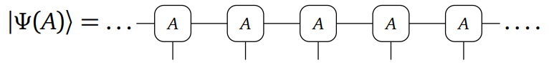
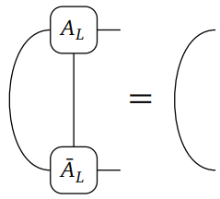
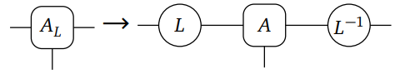
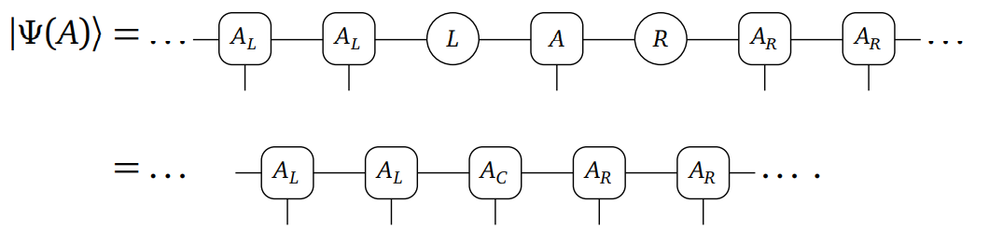
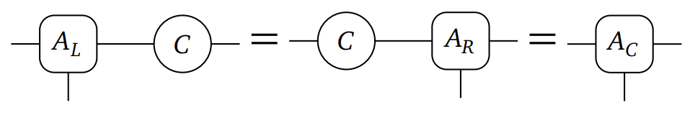
orthonormal form or mixed gauge
UMPS
Gauge transform
orthonormal form
C = LR

Slide 5
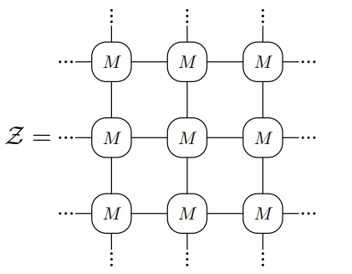
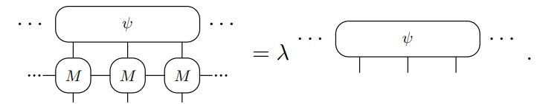
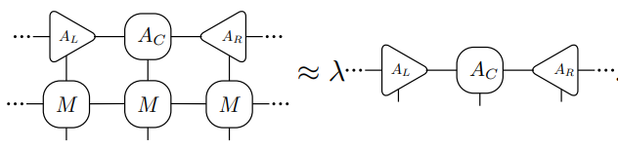
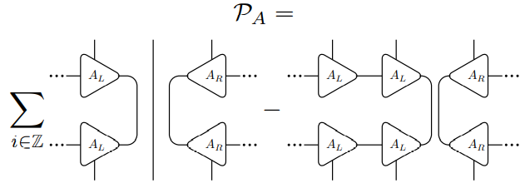
2D ising contract
orthonormal form
Project to tangent space

Slide 6
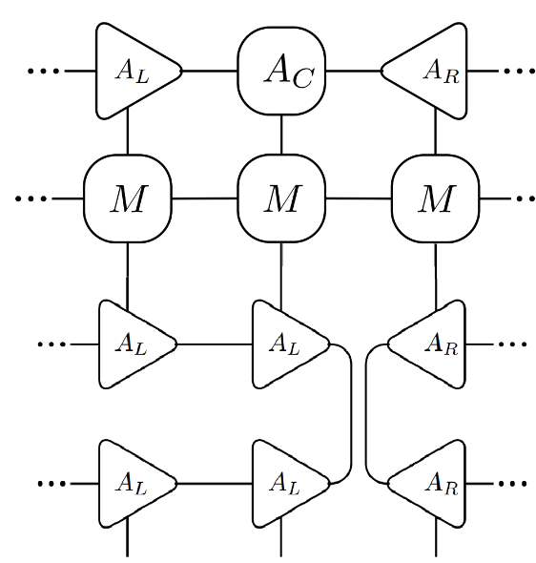
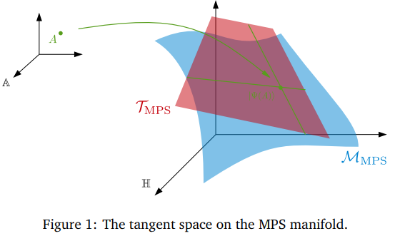
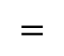
Project to tangent space
$$=$$

Slide 7
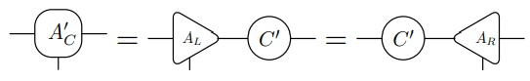
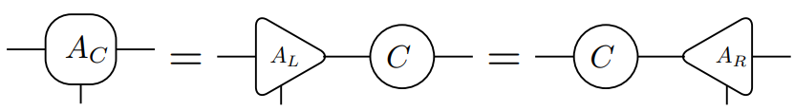
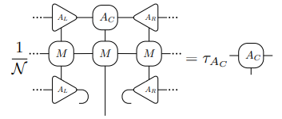
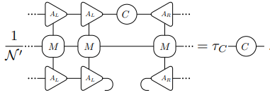
VUMPS fixed point
Unique C gauge transform

Slide 8
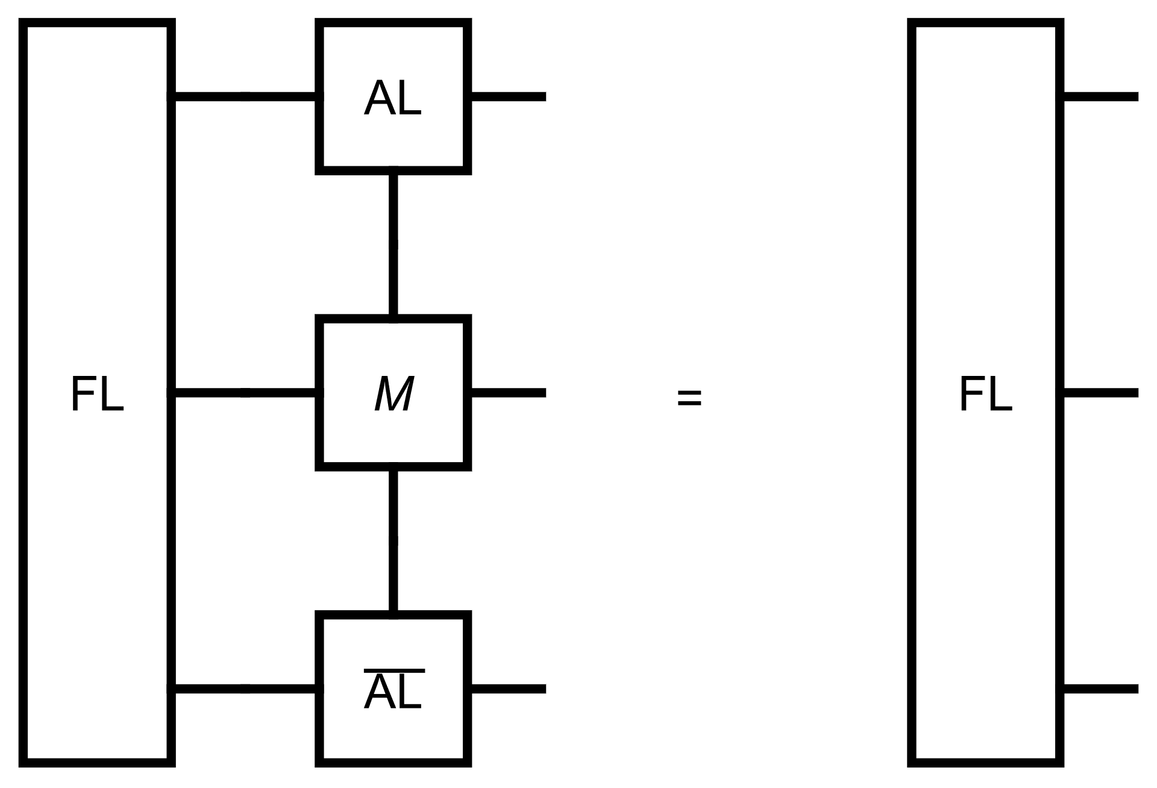
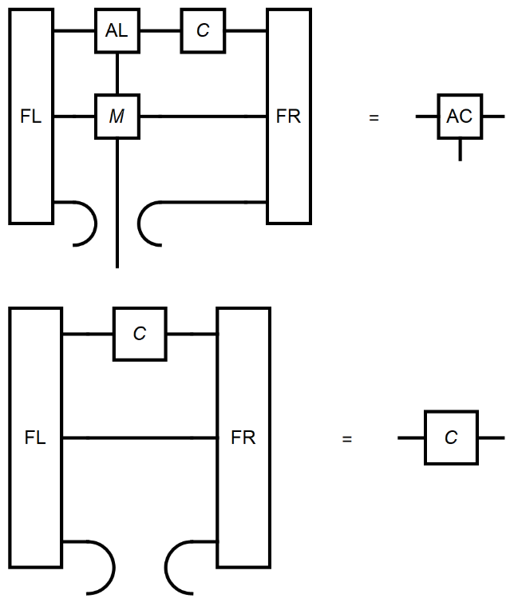
Environment
Left and right environment

Slide 9

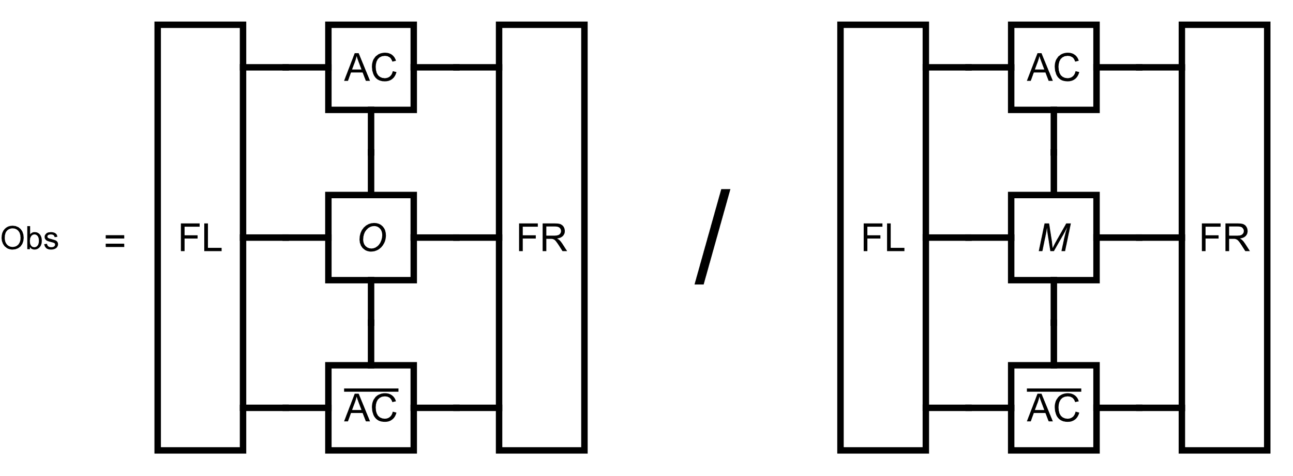
VUMPS-algorithm
# Initial orthonormal form MPS
M = classical2Disingmpo(β; J = 1.0, h = 0.)
AL,C = leftorth (A)
AR = rightorth (AL,C)
while error(AC,FL,FR,M) > tol_error
# Get environment
FL = leftenv(AL, M)
FR = rightenv(AR, M)
# Get orthonormal form
AC, C = vumpsstep(AL, C, AR, M, FL, FR)
# calculate observable
Obs = obser(O, AC, M, FL, FR)

Slide 10
Calculate other observable

Slide 11
VUMPS-3Dising

Slide 12
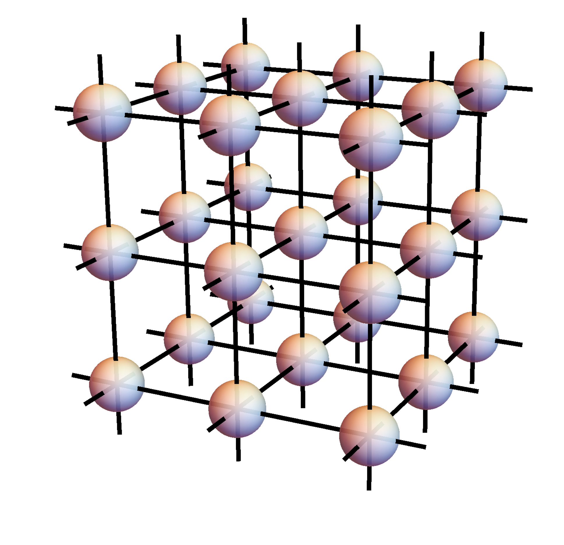
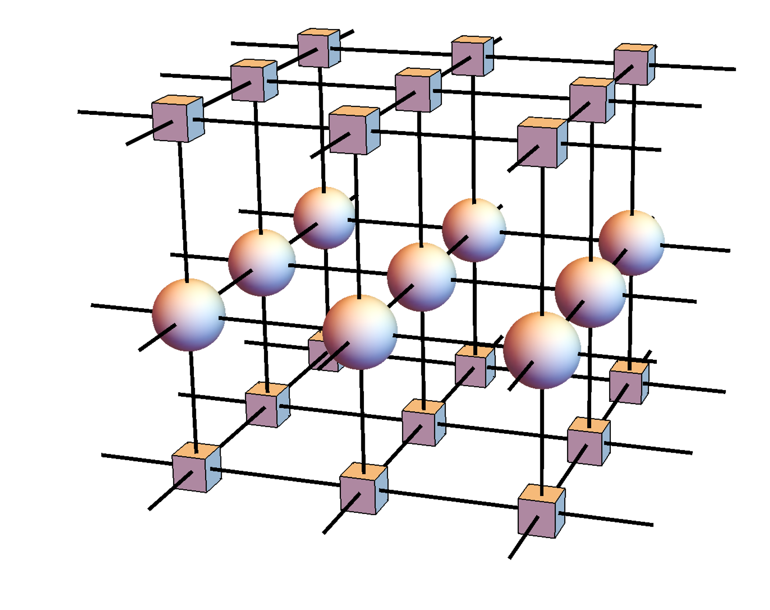
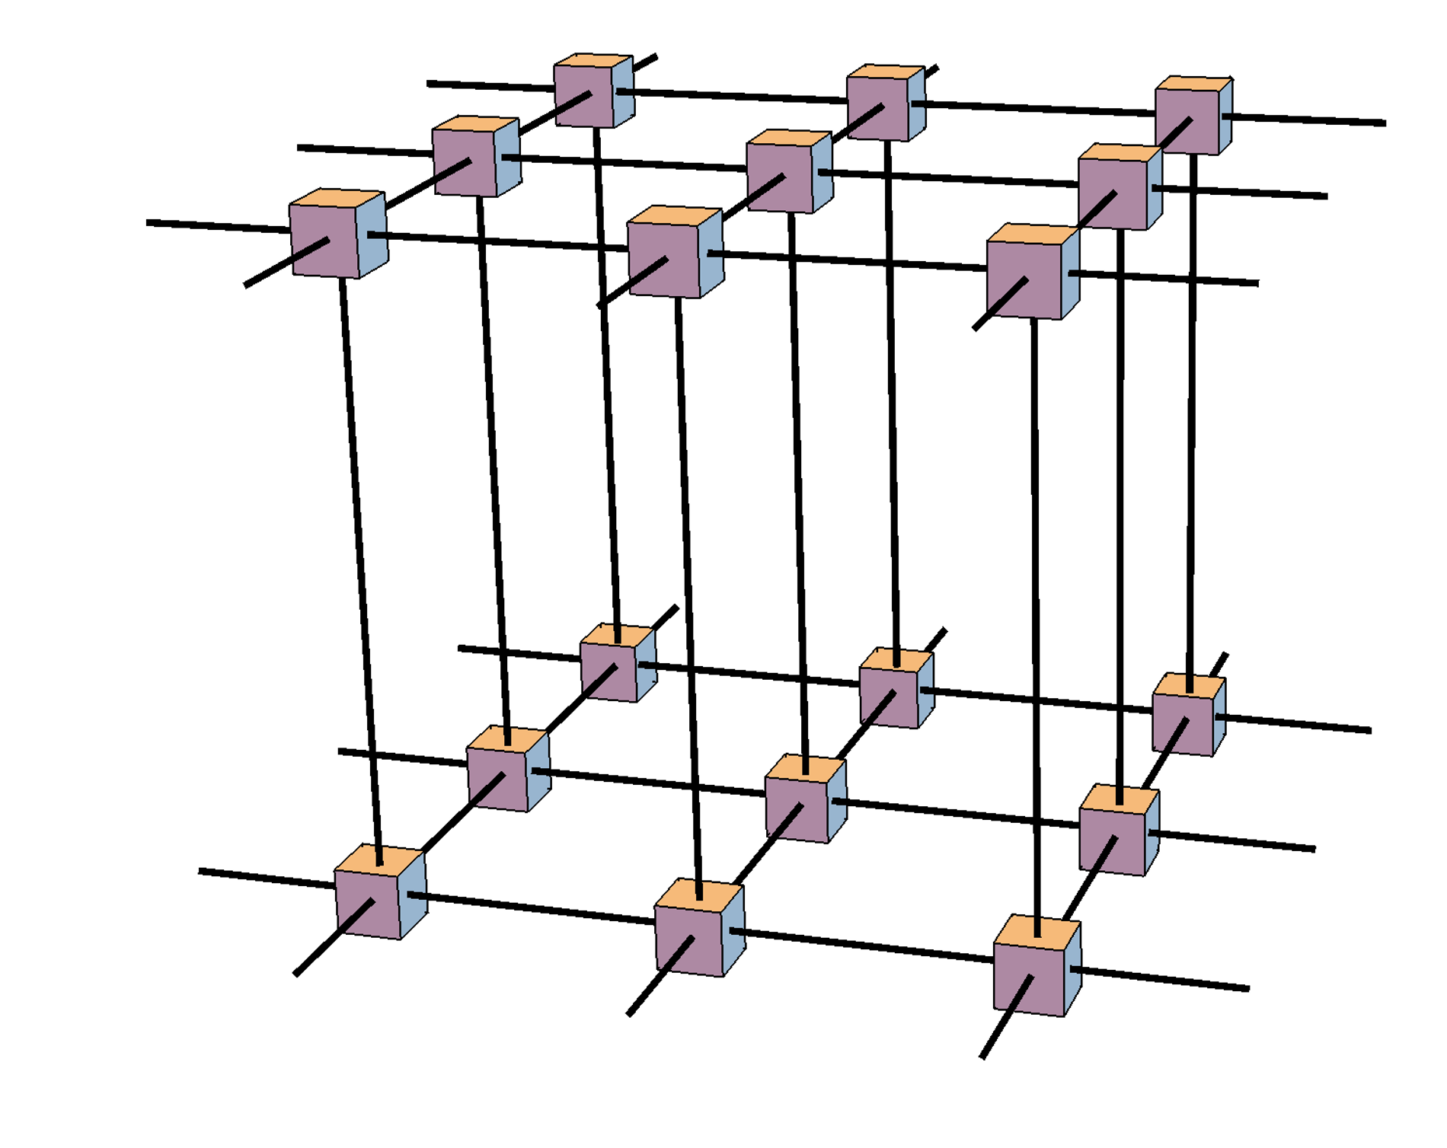
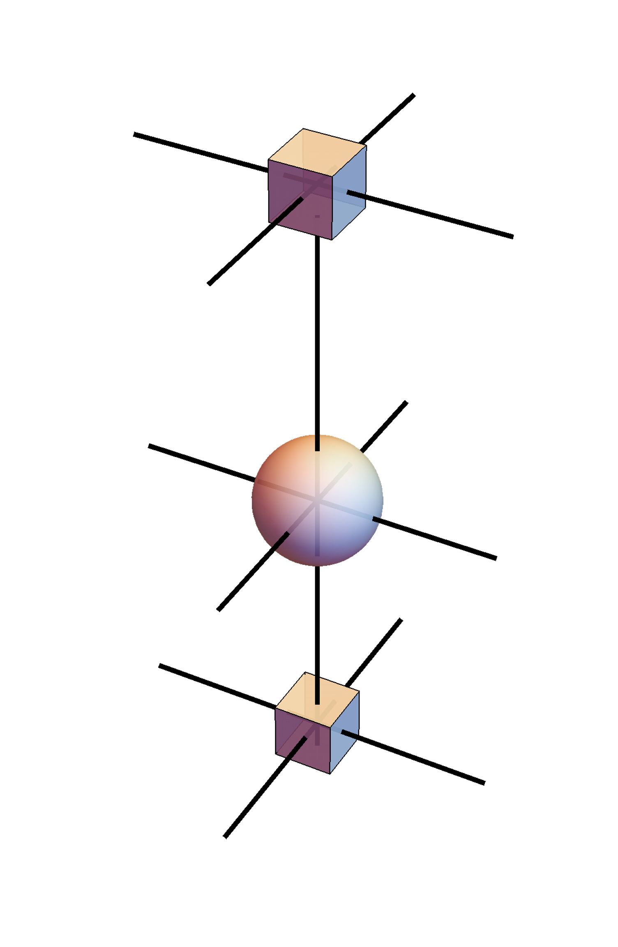
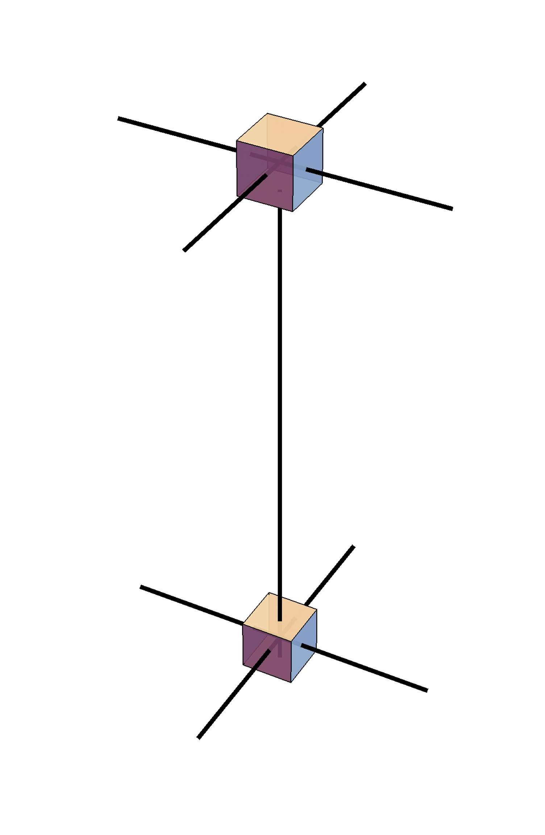
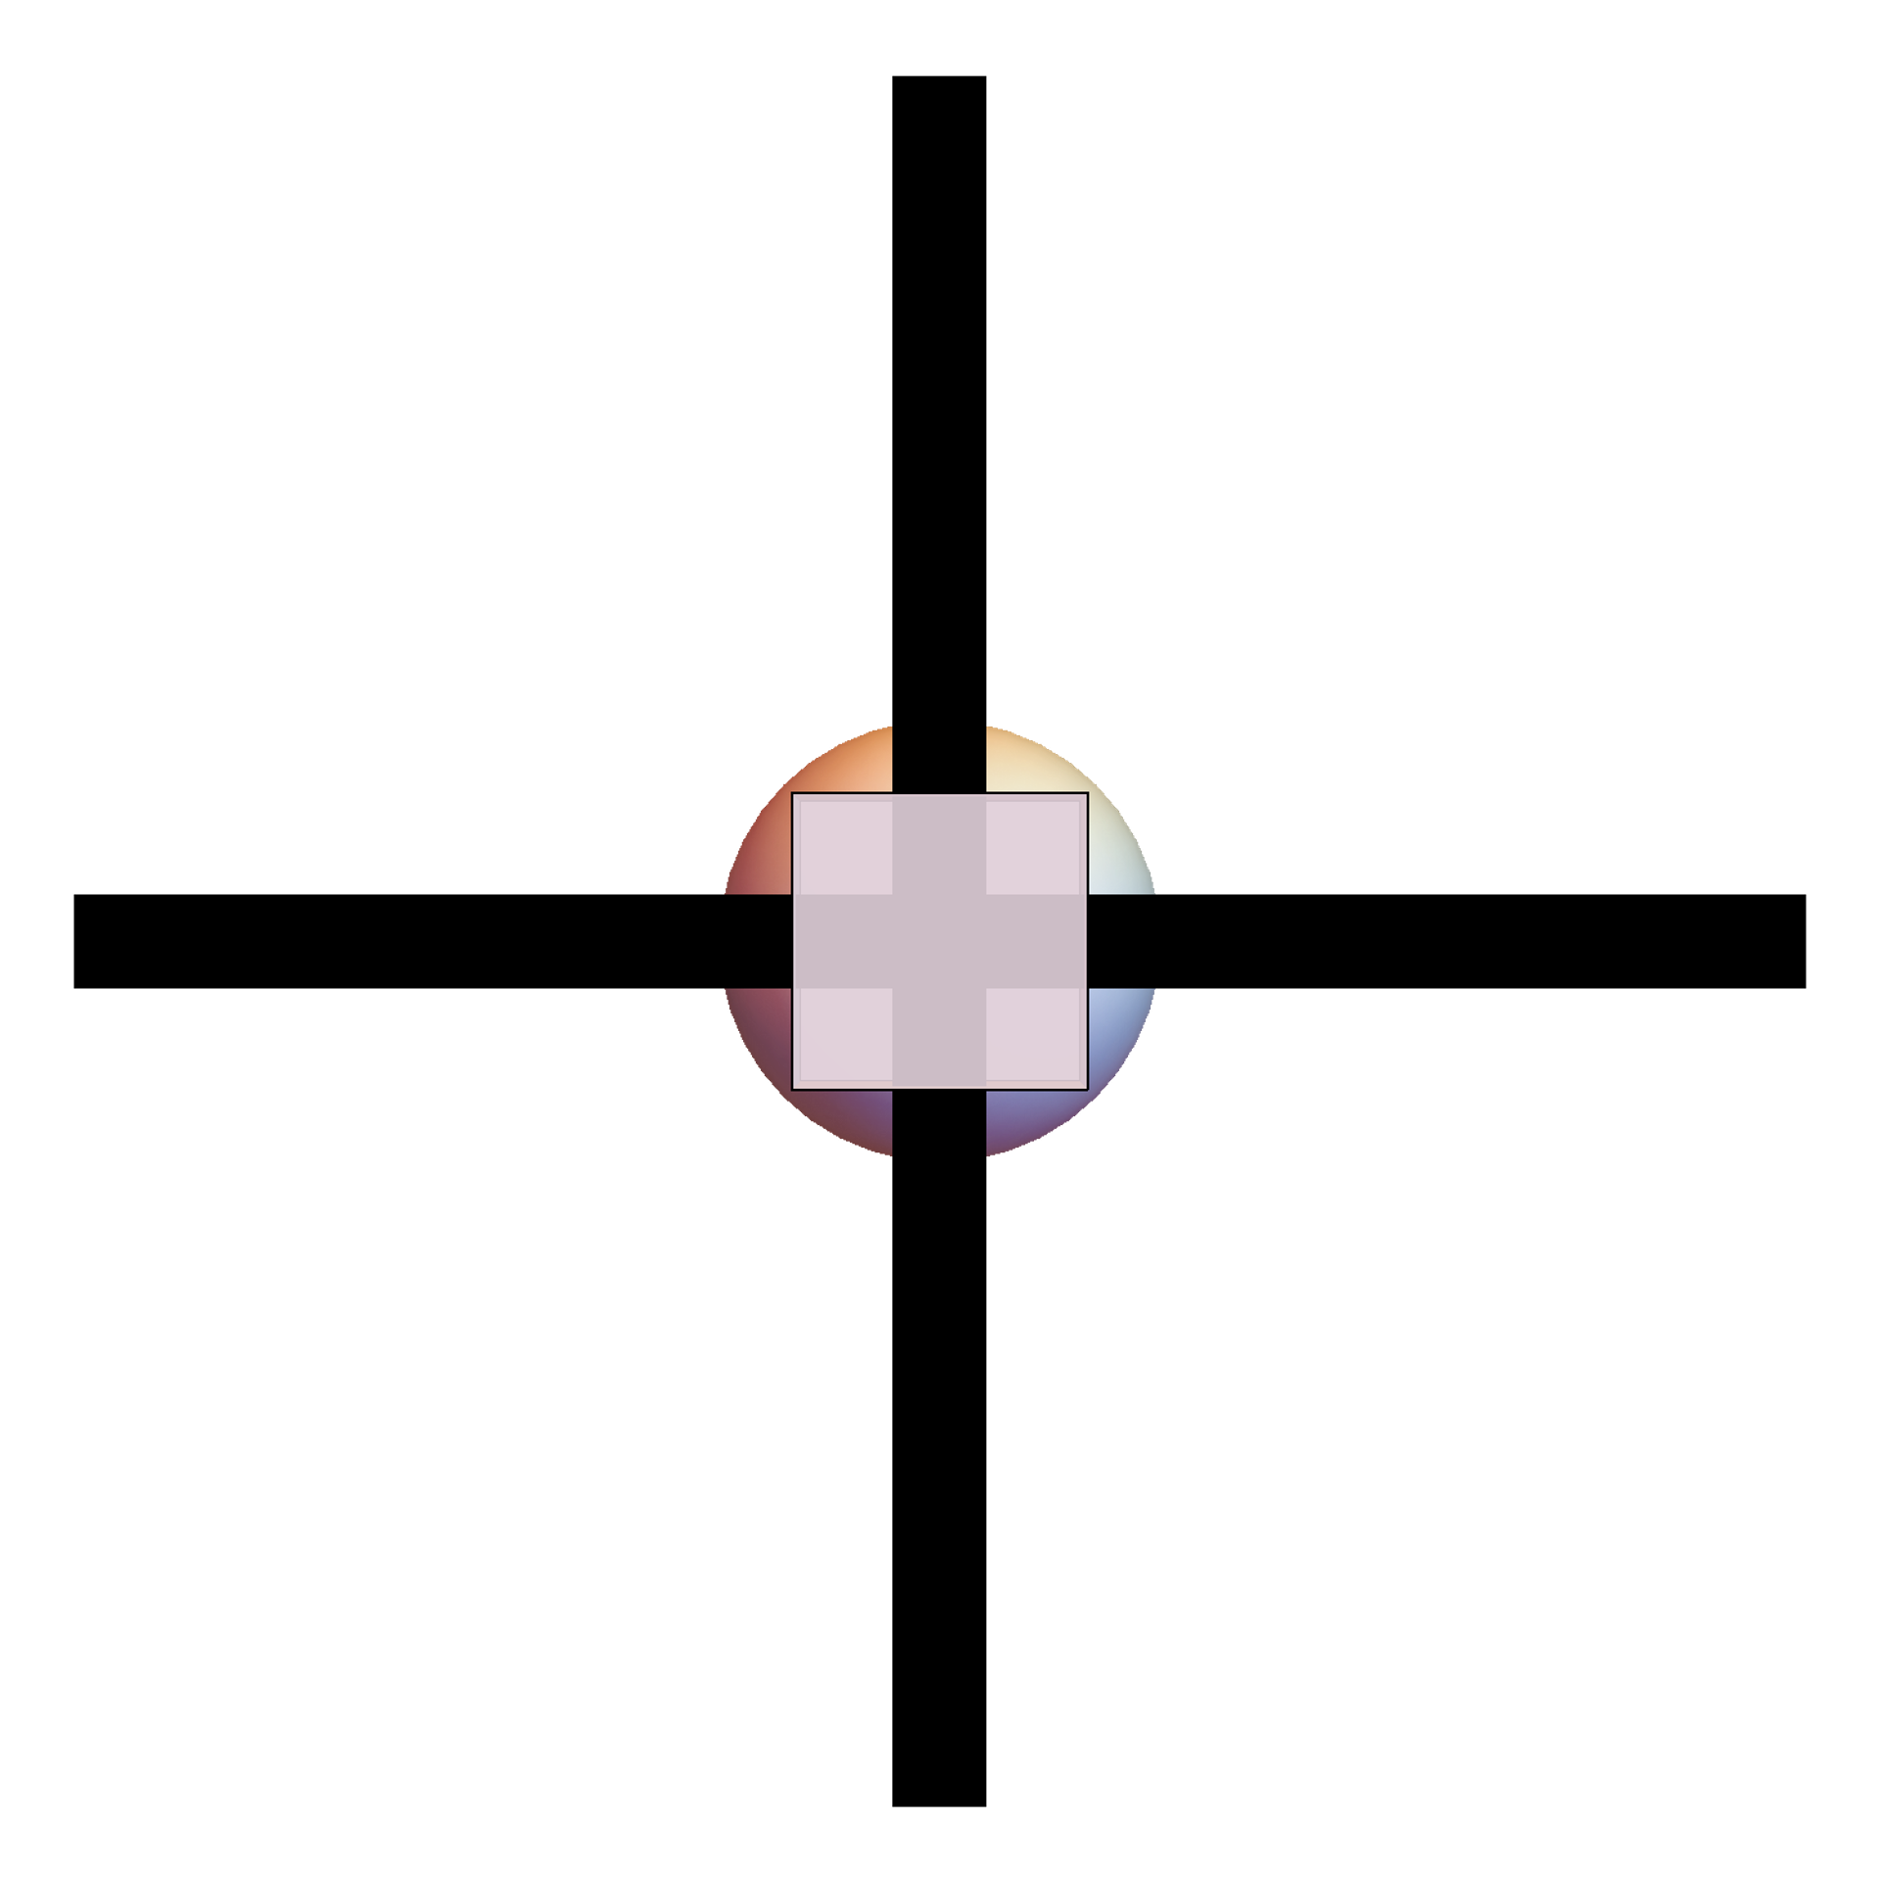
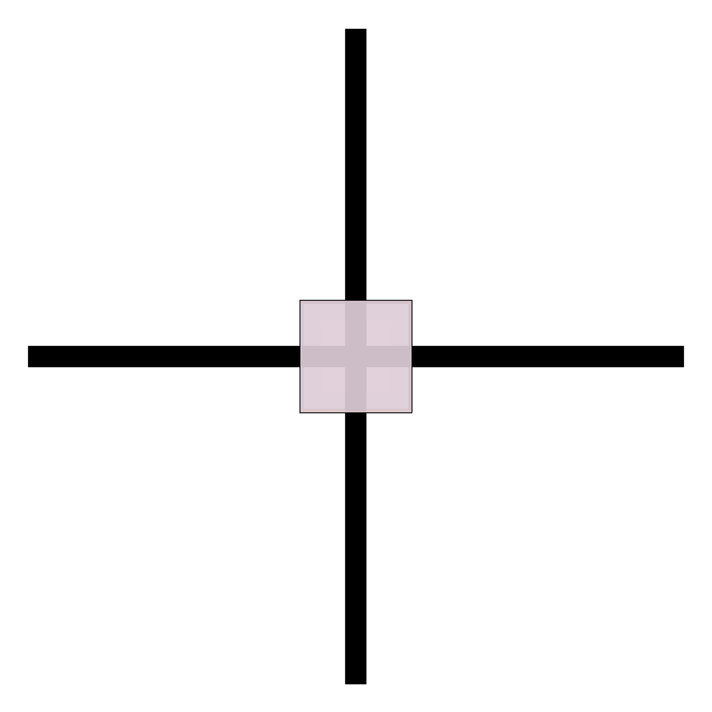

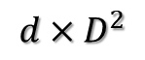
3D ising contract
PEPS
Z =
=
/
single
z =
A
D
D
$$d×D^{2}$$
$$D^{2}$$
contract to 2D
M
/
/
d
M1
M2
A
D
D

Slide 13
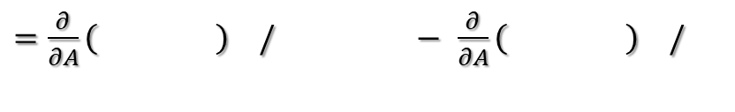
Gradient to single site
/
contract with VUMPS
M1
M2
/
Free energy for single site = $−\frac{1}{N}\log{Z}$ = $−\log{z}$ = $−\log{( )}$
Gradient = $−\frac{∂}{∂A}\log{z}$ =$−\frac{∂}{∂A}\left[−\log\left( \right)+\log\left( \right) \right]$
$=\frac{∂}{∂A}\left( \right) /$ $−$ $\frac{∂}{∂A}\left( \right) /$

Slide 14
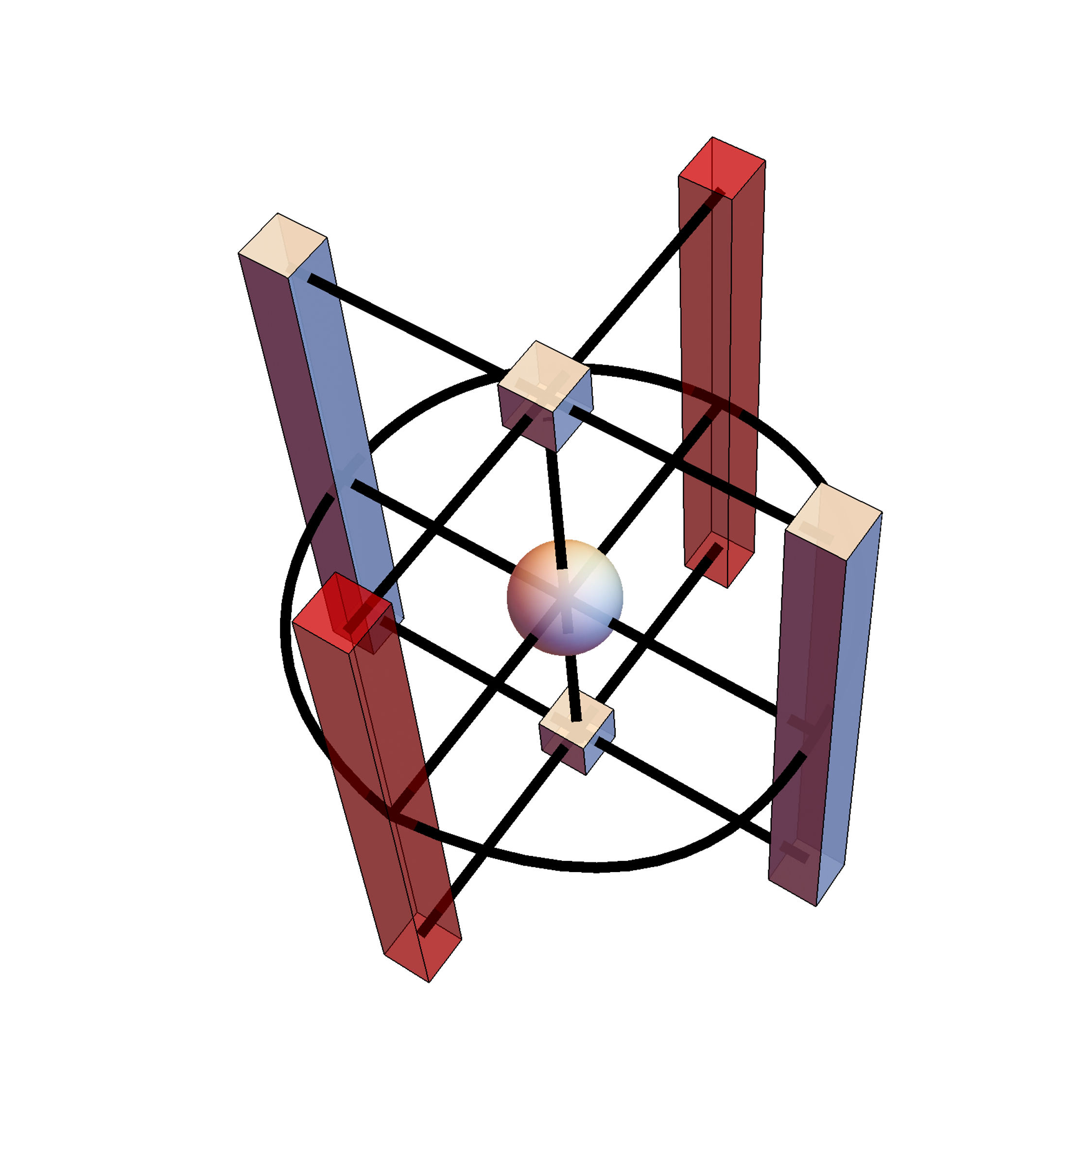
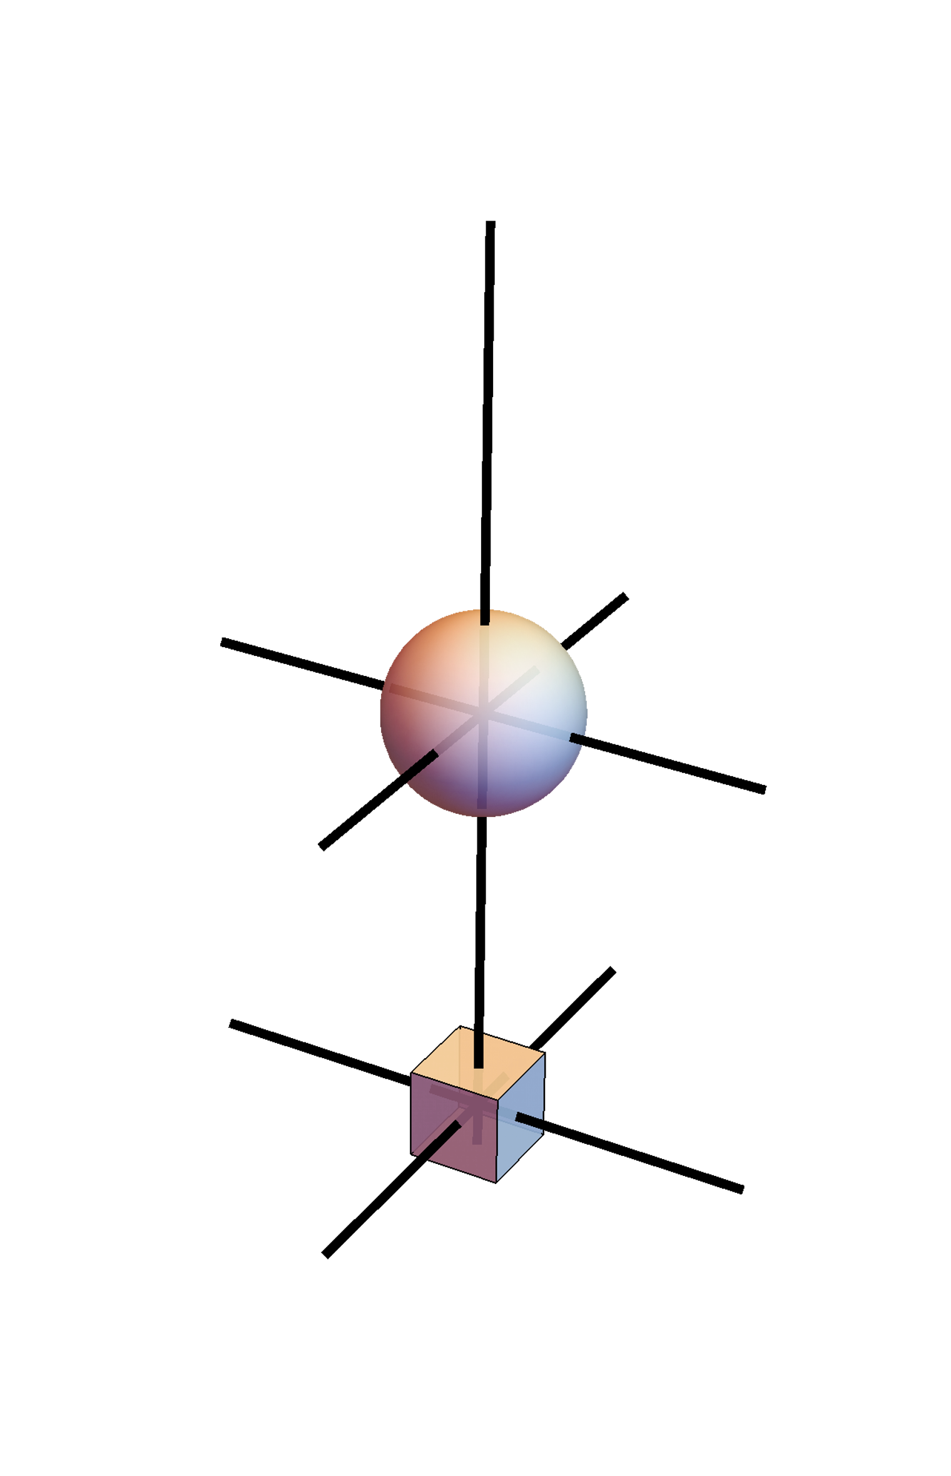
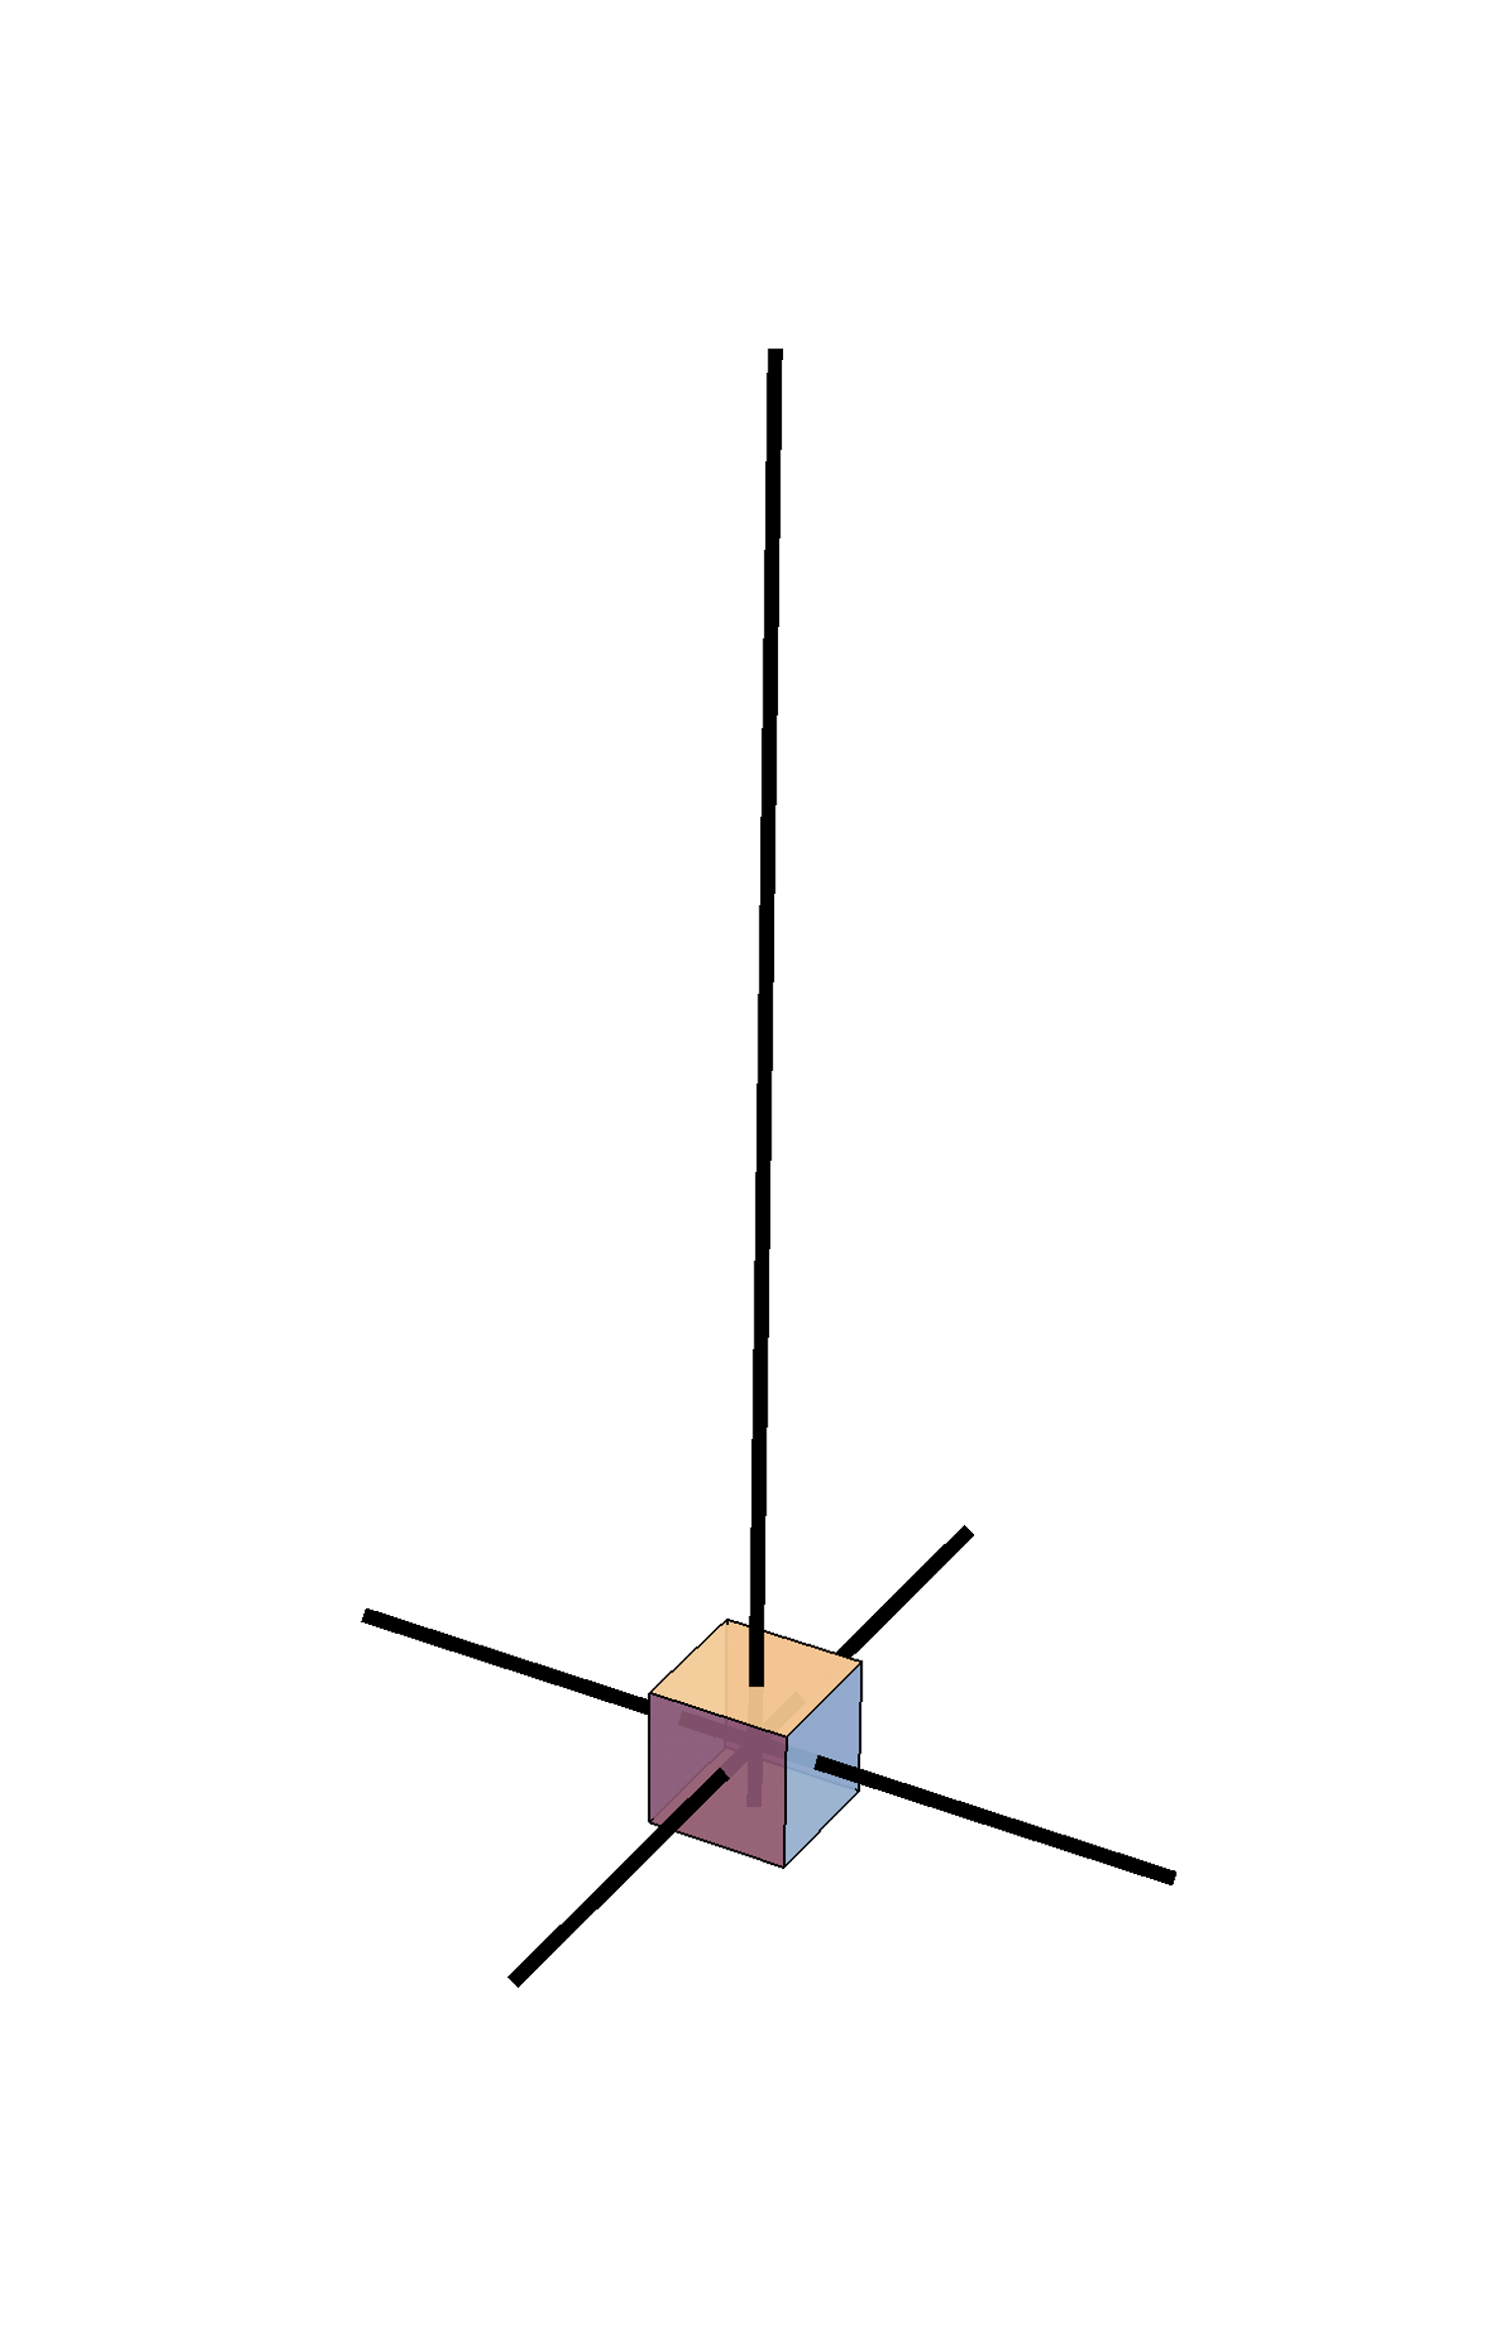
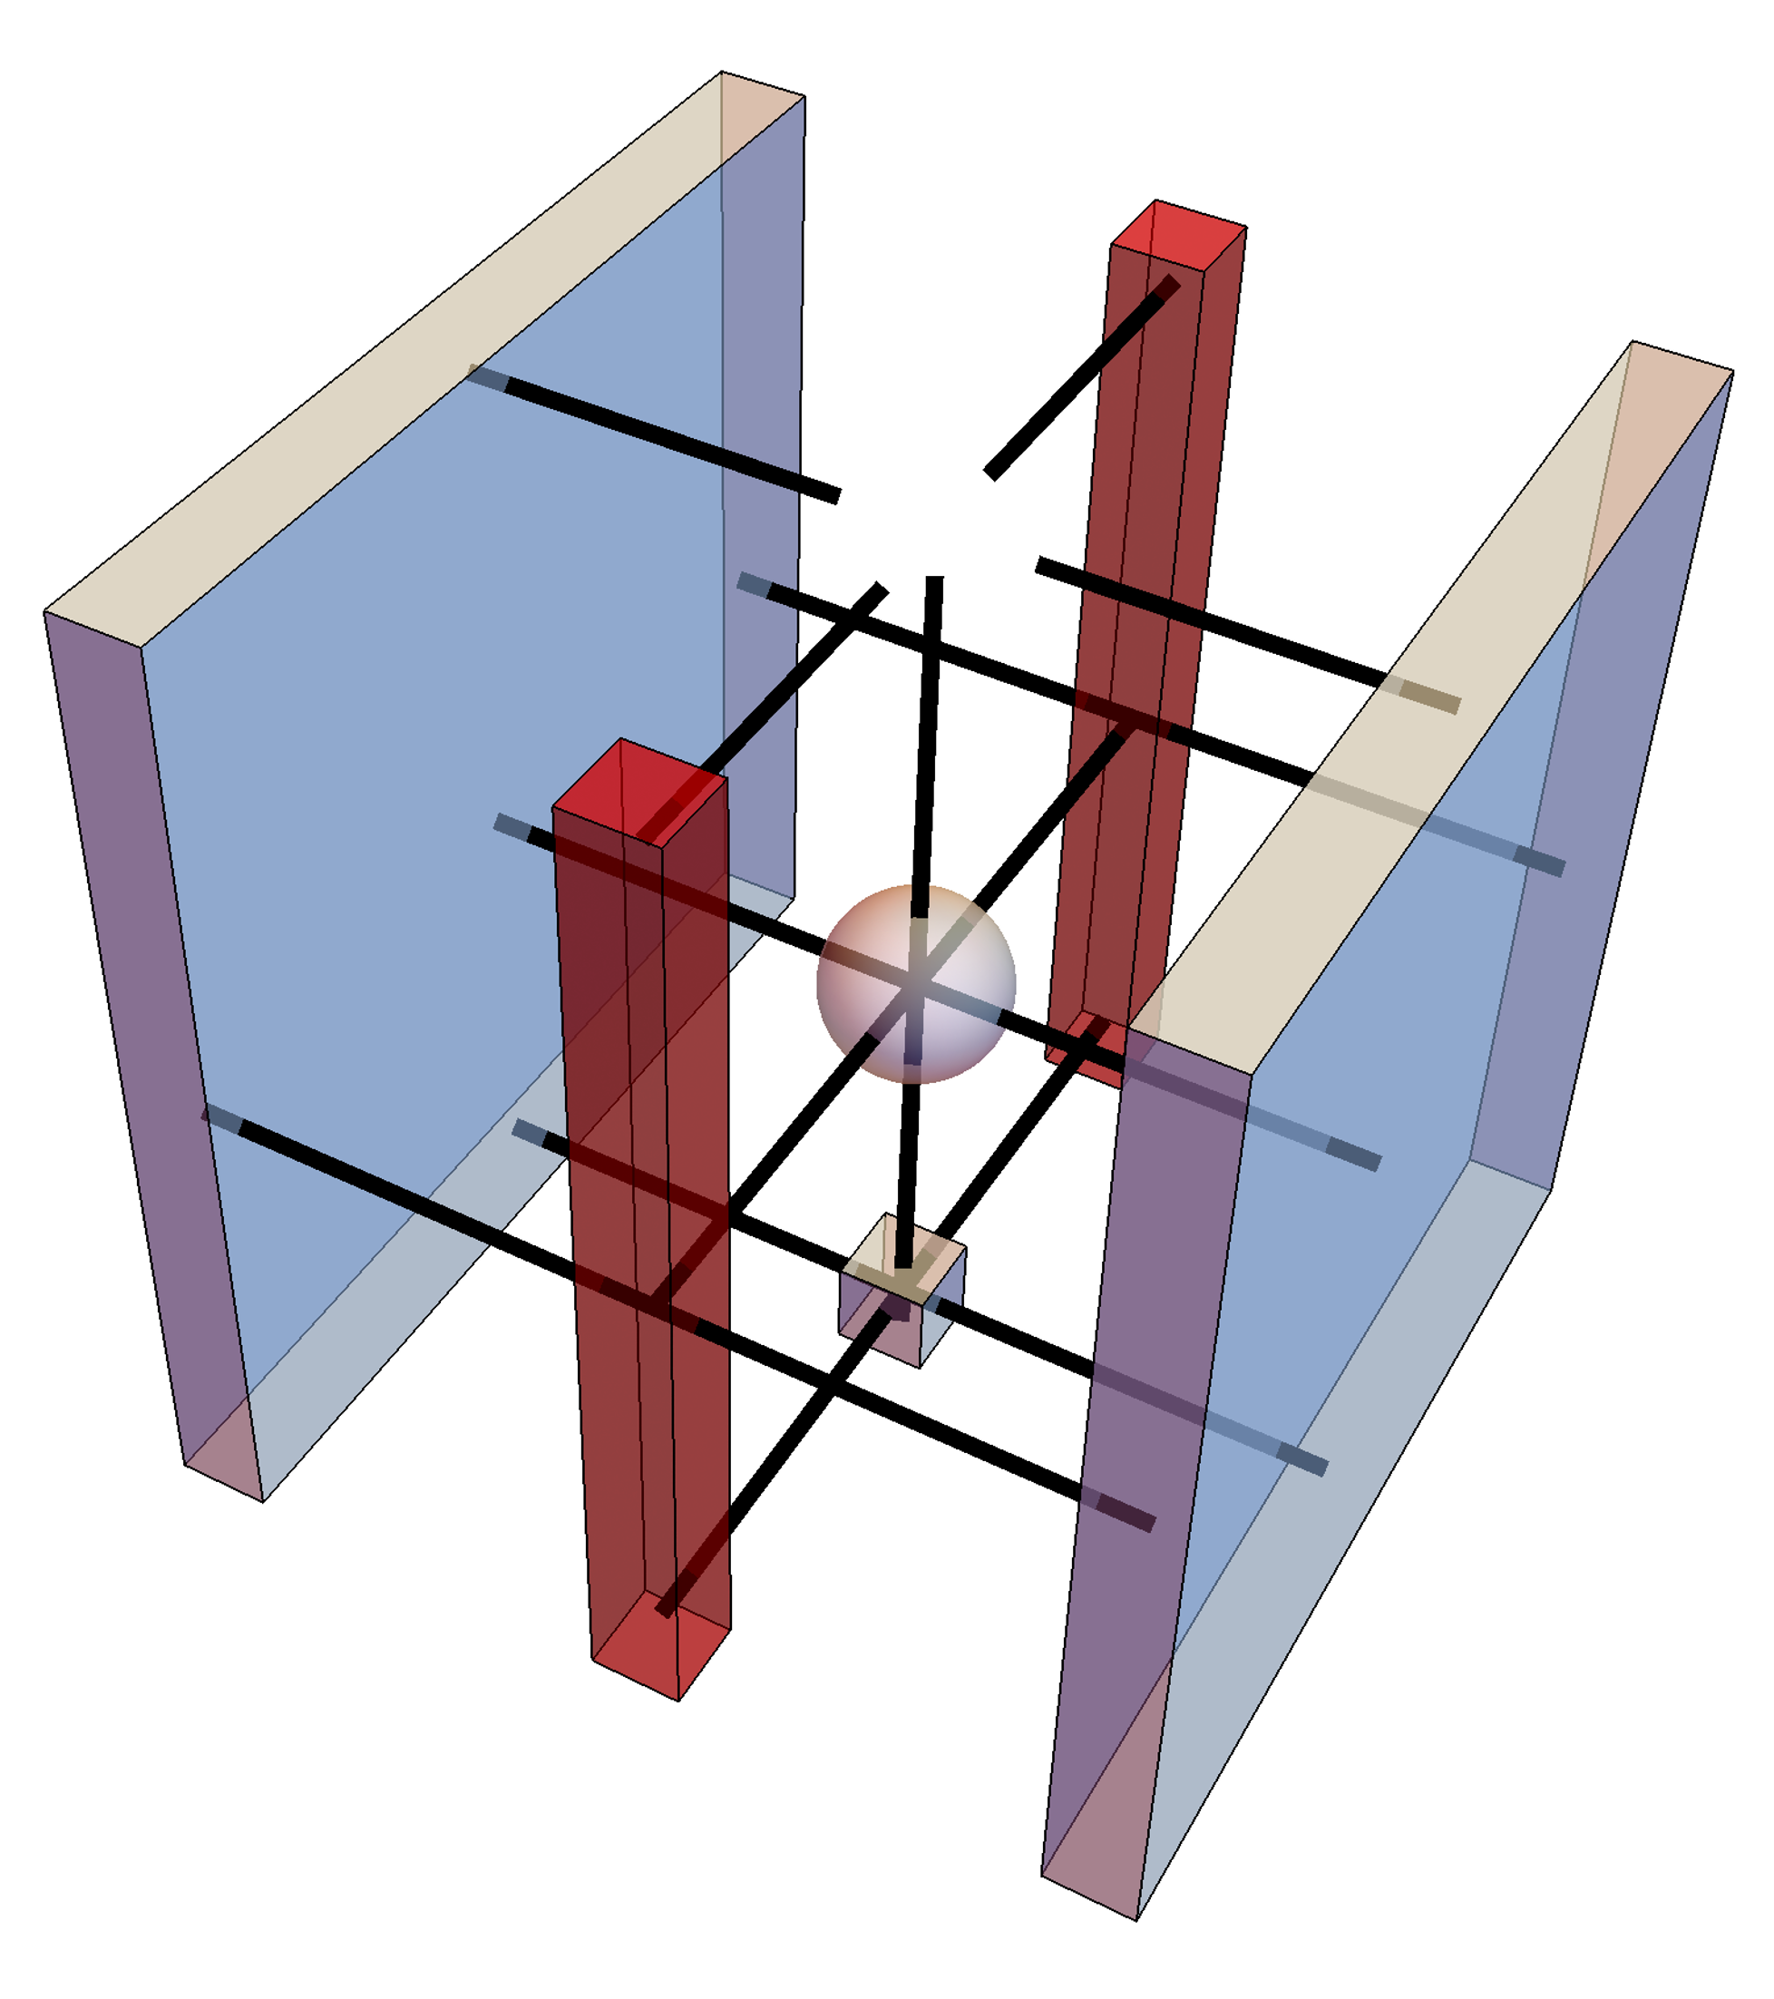
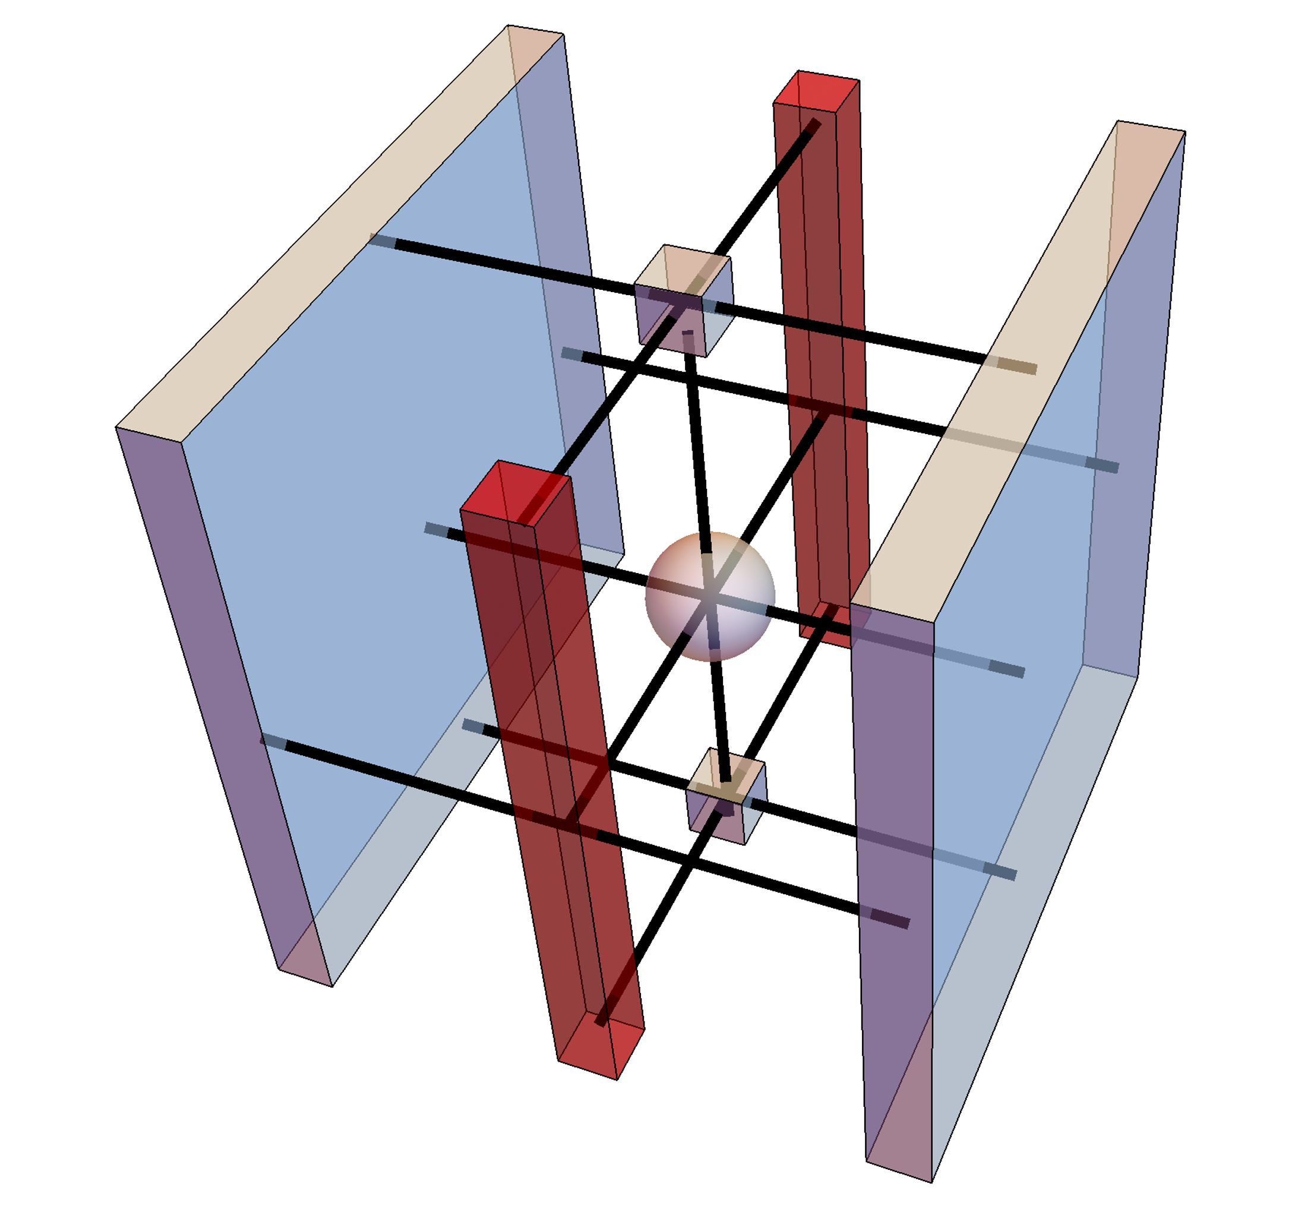
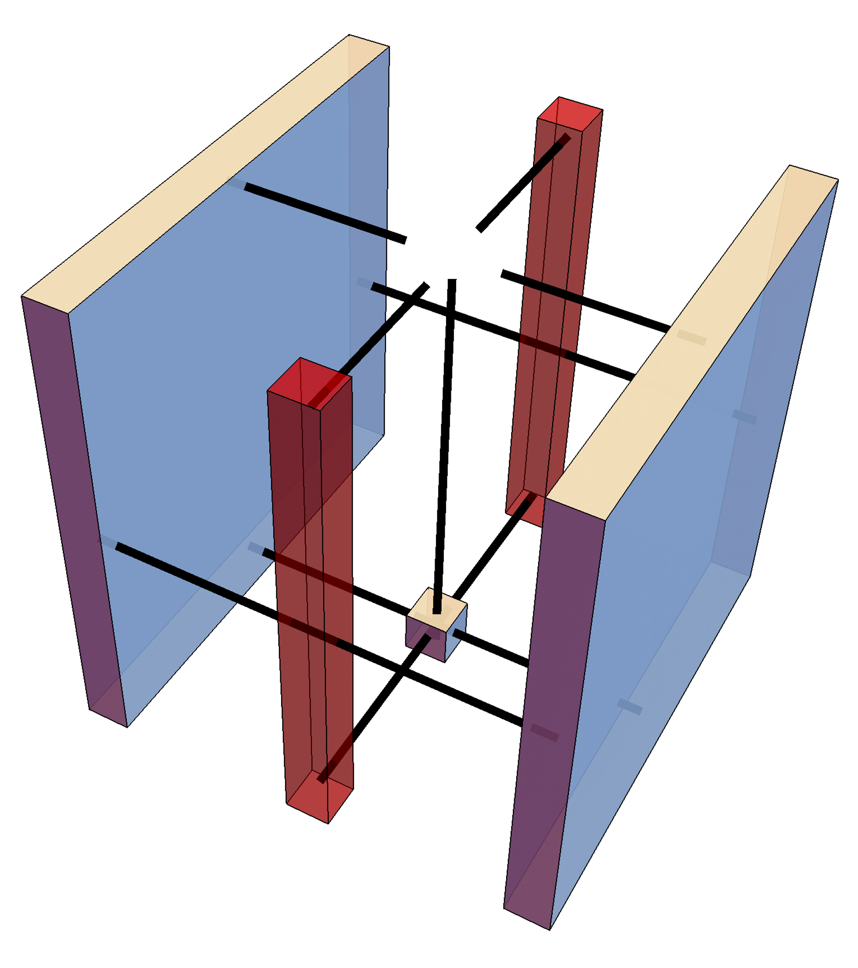
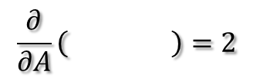
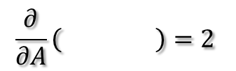
Gradient to and
$$\frac{∂}{∂A}\left( \right)=2$$
$$\frac{∂}{∂A}\left( \right)=2$$
3D view
add envir

Slide 15
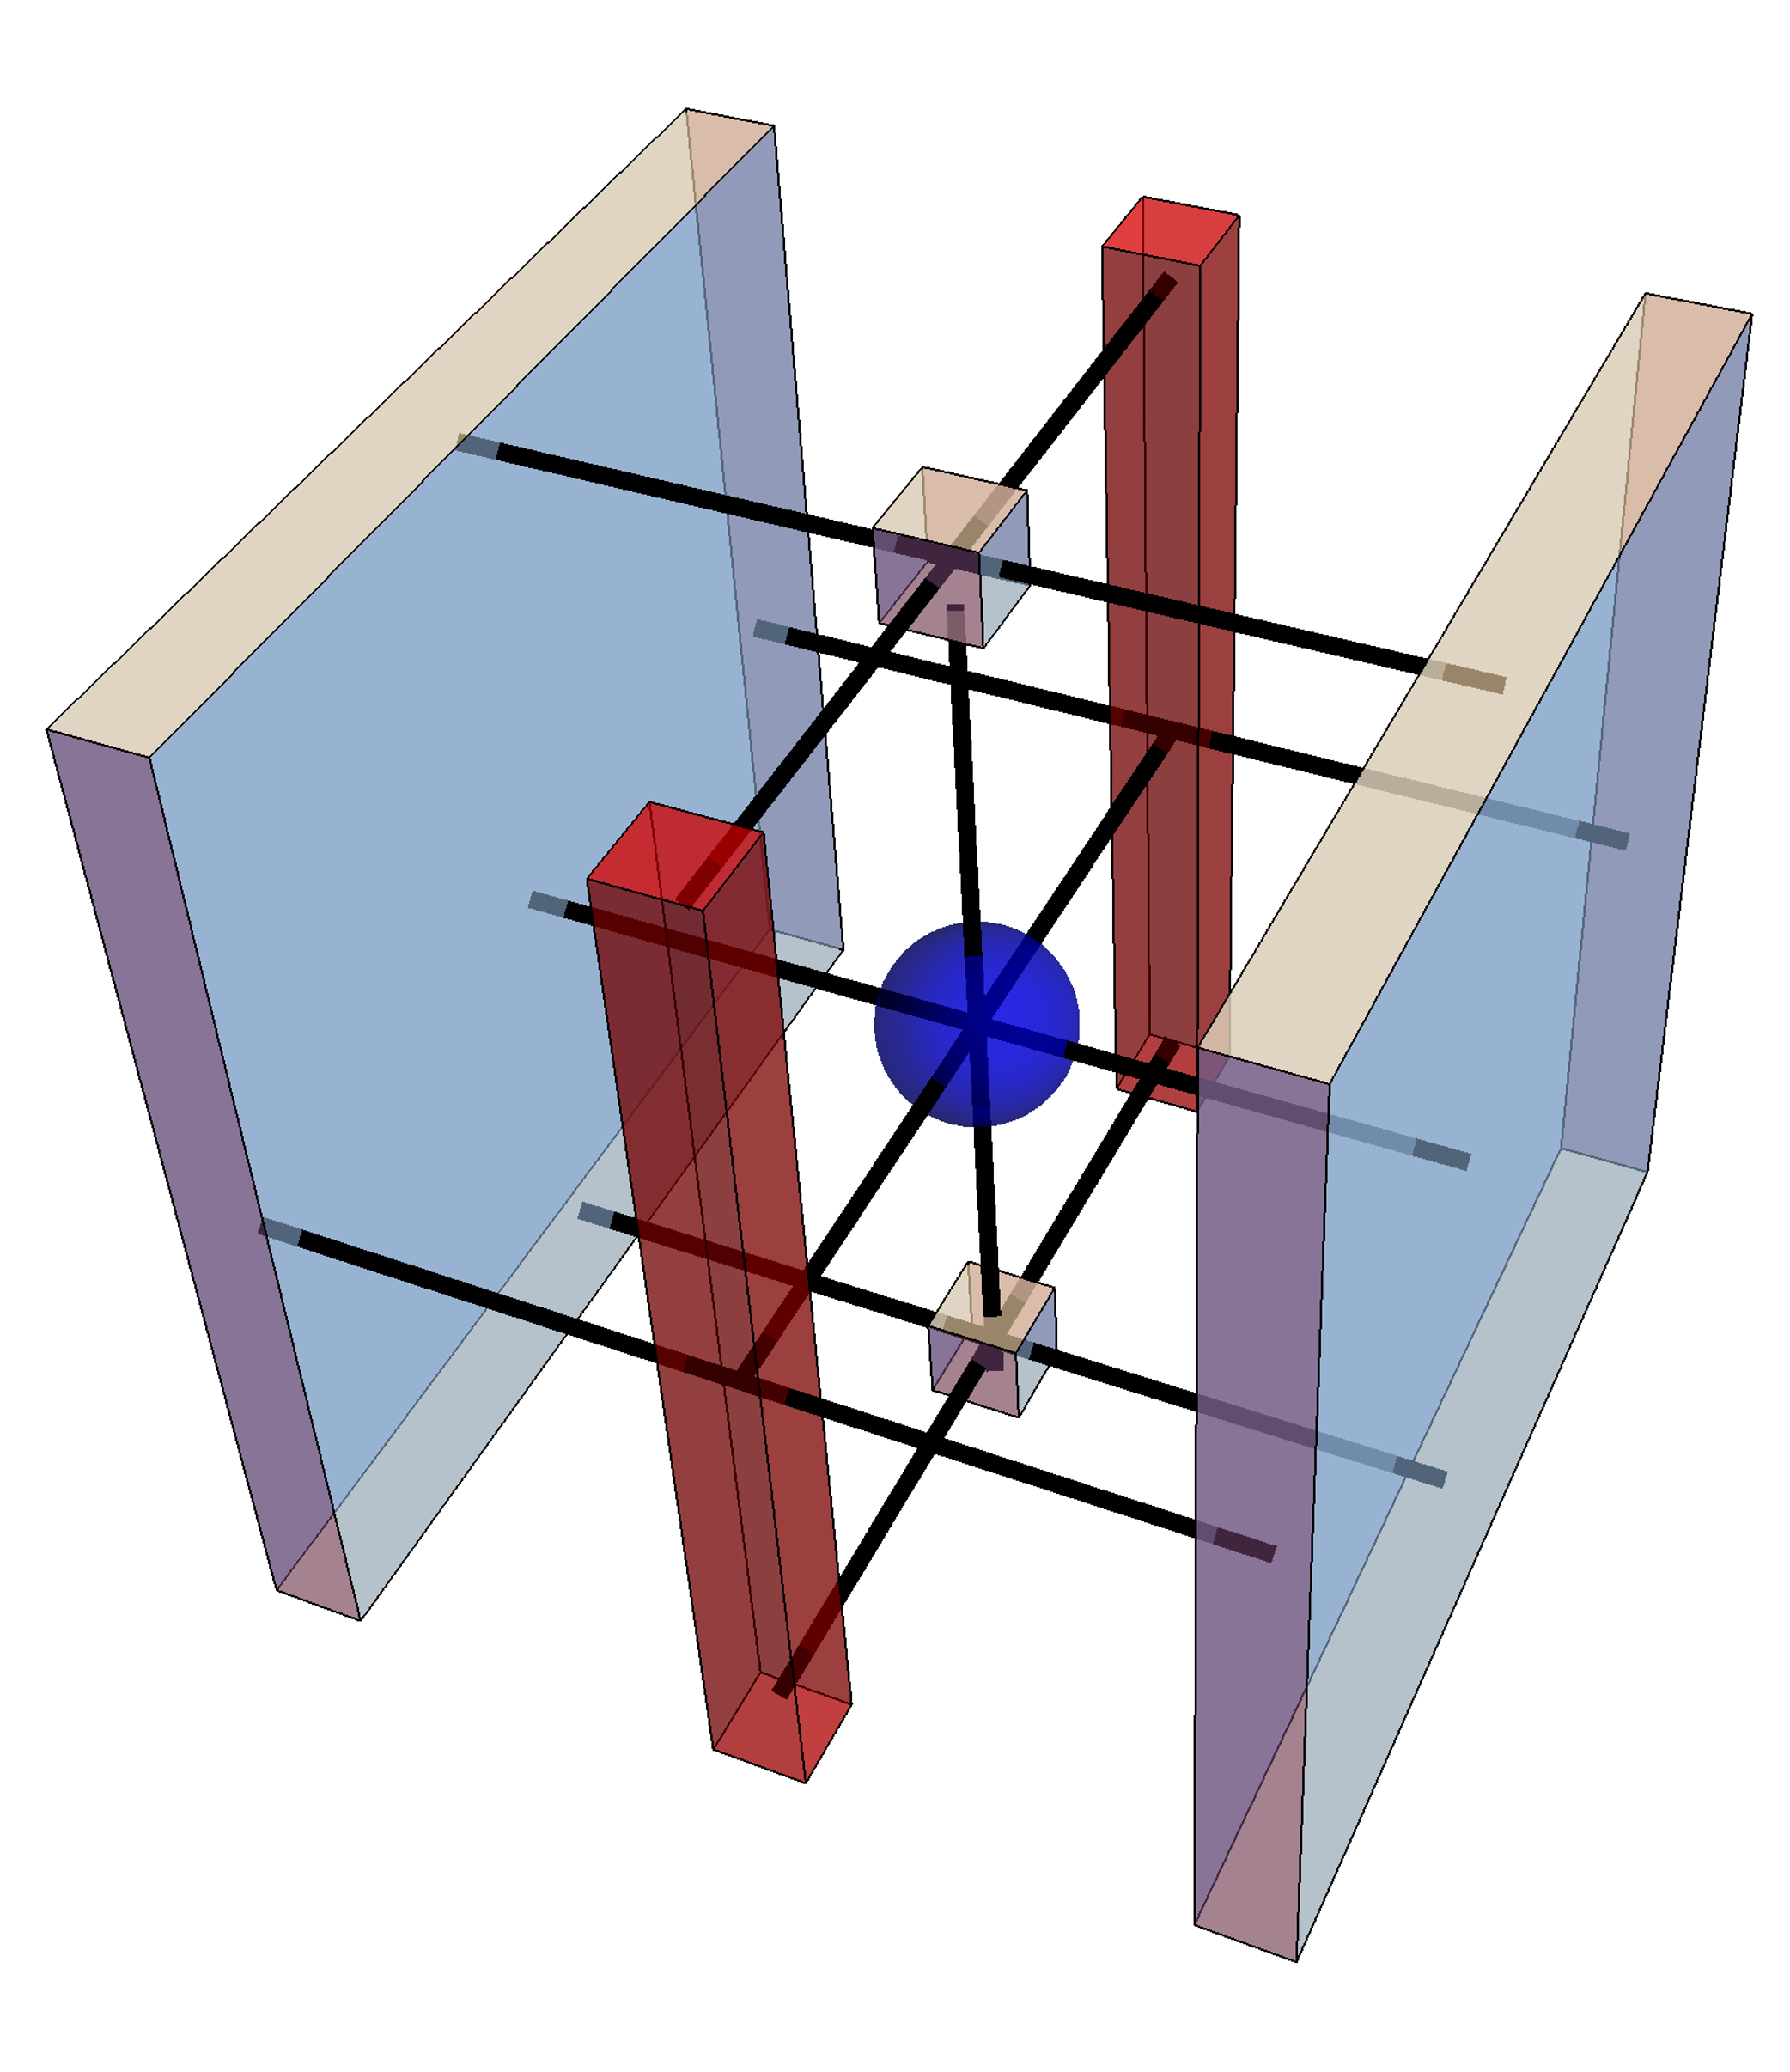
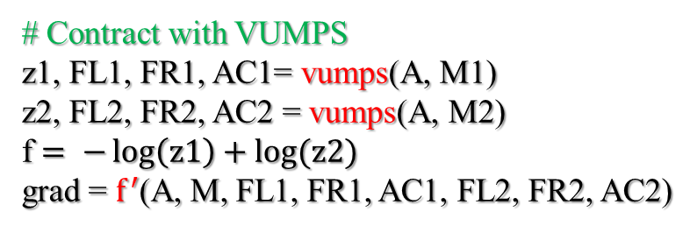
3Dising-algorithm
# Initial uniform form PEPS
M = classical3Disingmpo(β; J = 1.0, h = 0.)
M1, M2 = build(A, M)
M1
M2
# Contract with VUMPS
z1, FL1, FR1, AC1= vumps(A, M1)
z2, FL2, FR2, AC2 = vumps(A, M2)
f $= −\log\left(z1\right)+log⁡(z2)$
grad = $f^{′}$(A, M, FL1, FR1, AC1, FL2, FR2, AC2)
# Optimize free energy
f = optimizer (f, grad)
/
# calculate observable
Obs = obser(A, O, M, FL2, FR2, AC2)

Slide 16
Big Cell PEPS

Slide 17
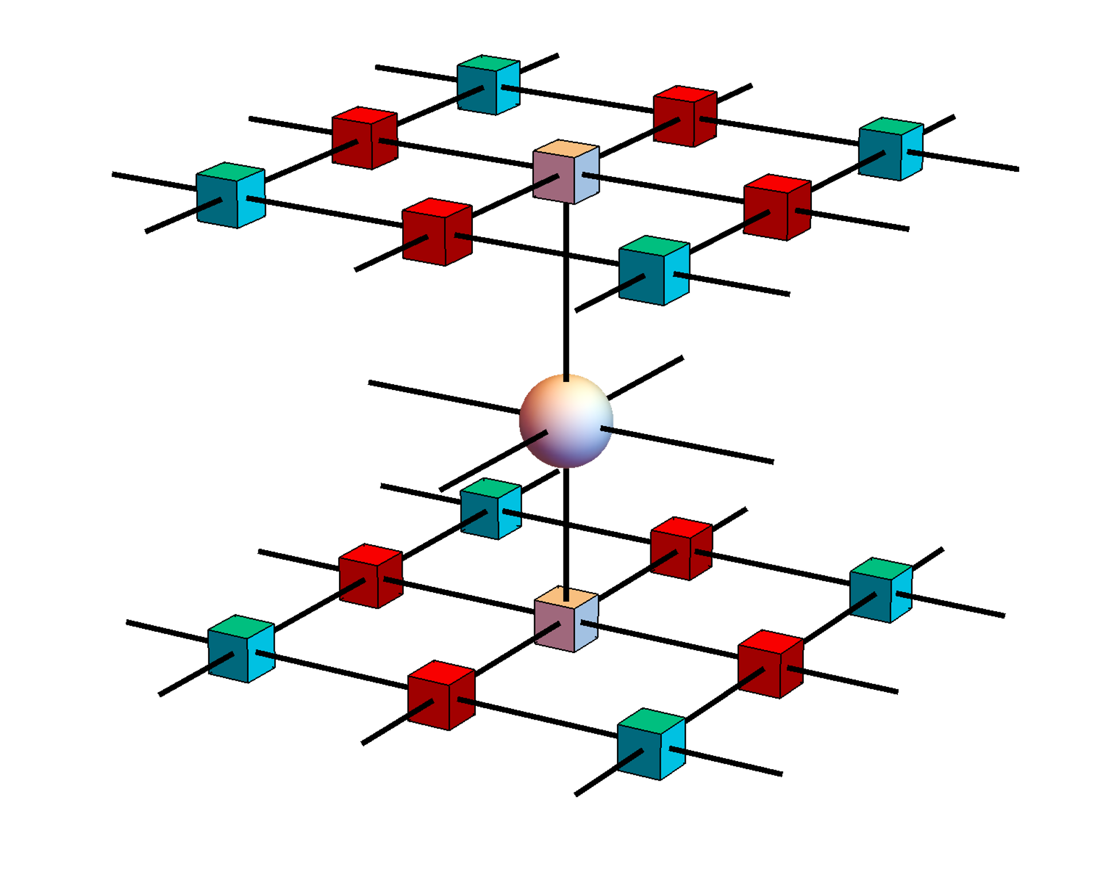
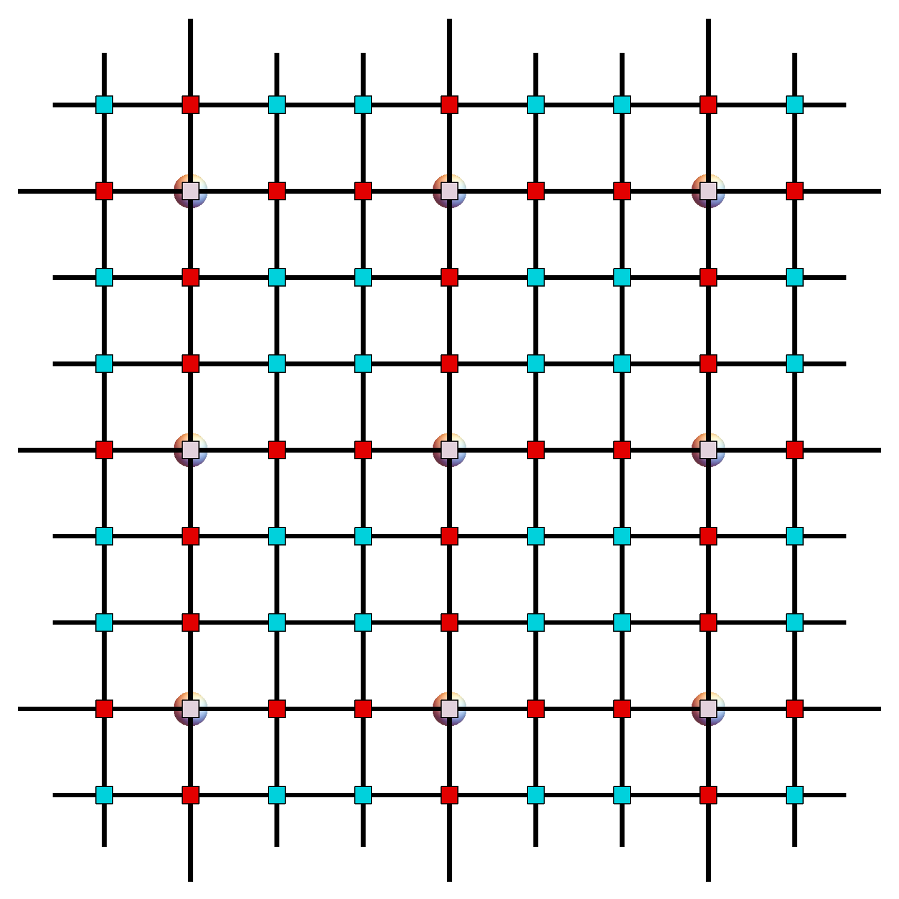
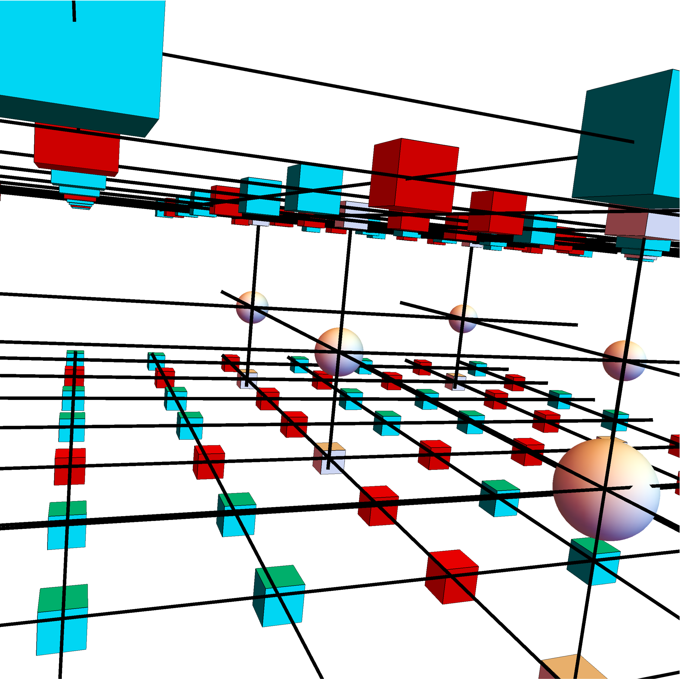

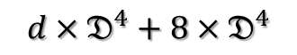

Big Cell
$$D=𝔇^{3}$$
$$d×D^{4}$$
$$d×𝔇^{4}+8×𝔇^{4}$$
Add edge and corner PEPS

Slide 18
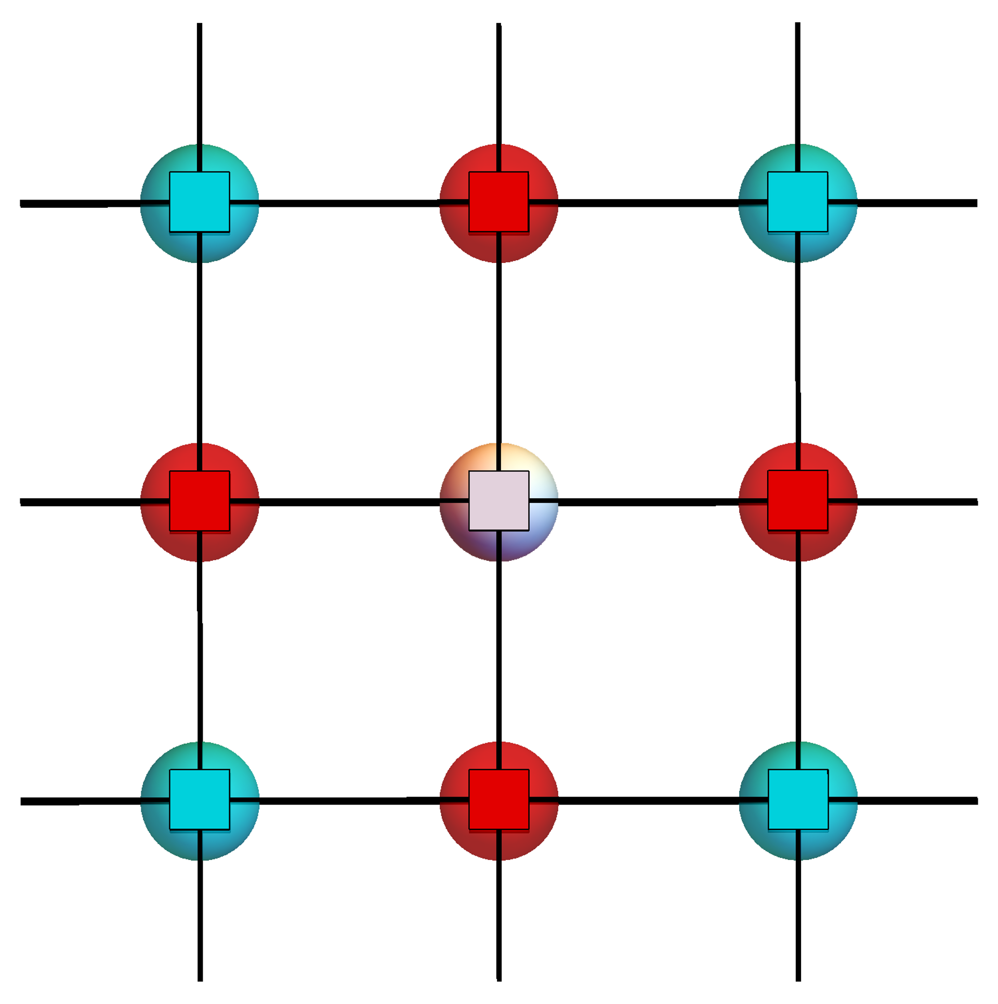
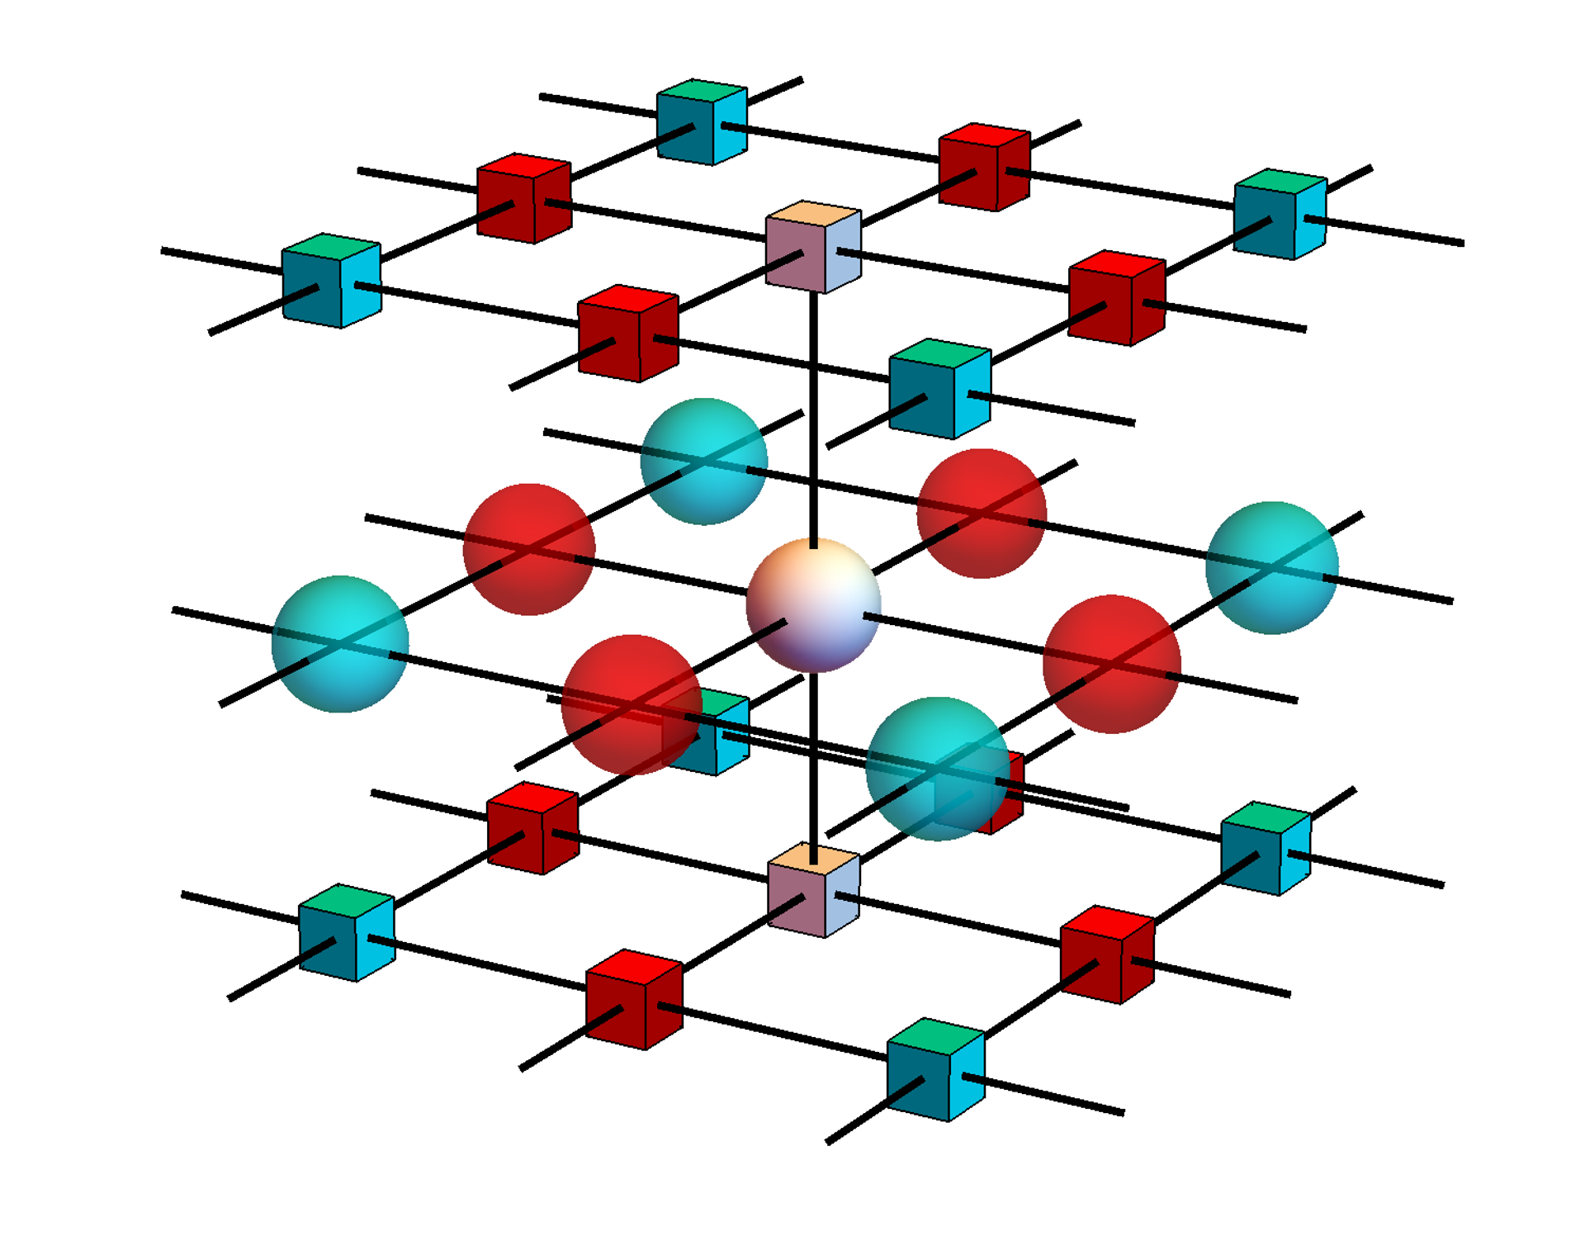
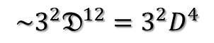
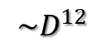
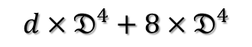
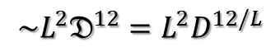

Big Cell
$$D=𝔇^{3}$$
$$d×D^{4}$$
$$d×𝔇^{4}+8×𝔇^{4}$$
Add edge and corner PEPS
$${\sim D}^{12}$$
$${\sim 3^{2}𝔇}^{12}=3^{2}D^{4}$$
get 3 types M
$${\sim L^{2}𝔇}^{12}=L^{2}D^{12/L}$$
Add δ tensor
M2
M3
M1
contract to 2D

Slide 19
Big Cell VUMPS

Slide 20
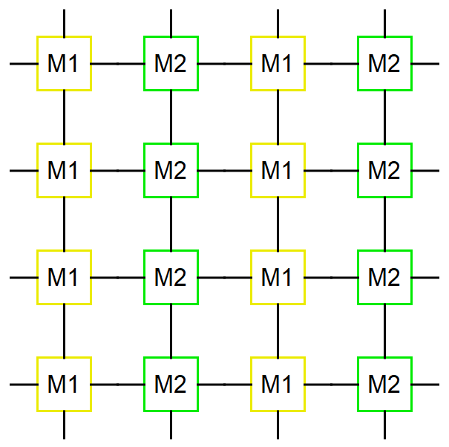
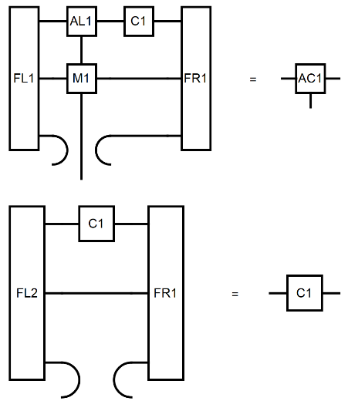


1$×$2 & 2$×$1
lattice
vumpsstep
environment

Slide 21



1$×$2 & 2$×$1
lattice
vumpsstep
environment

Slide 22

Environment for every $M_{ij}$
Obs
O
/

Slide 23



BCVUMPS-algorithm
# Initial orthonormal form MPS
$M_{ij}$ = mpo(params)
${AL}_{ij},C_{ij}$= leftorth ($A_{ij}$)
${AR}_{ij}$ = rightorth (${AL}_{ij},C_{ij}$)
while error(AC,FL,FR,M) > tol_error
# Get environment
AL[i, j] = leftenv(AL[i , :], M [i , :])
AR[i, j]= rightenv(AR[i , :], M [i , :])
# Get orthonormal form
AC[i, j], C[i, j] = vumpsstep(AL[:, j], C[:, j], AR[:, j], M[:, j], FL[:, j], FR[:, j])
# calculate observable
Obs = obser(O, AC, M, FL, FR)

Slide 24



verify

Slide 25







Consider observable for 3$×$1 Cell
/
Obs1 =
/
Obs2 =
/
Obs3 =

Slide 26



expand
Must be Hermitian!

Slide 27


Correct observable
/
Obs1 =

Slide 28
BCVUMPS-3Dising

Slide 29





1$×$1 3Dising observable
lnZ
Get min lnZ

Slide 30




1$×$1 Gradient descent
-lnZ
gradnorm
magnetization

Slide 31




$1×3$ 3Dising observable

Slide 32


$1×3$Gradient descent
1x1 D=2 -0.777407
1.545e-05
1x3 D=2 -0.777422
1.758e-05
1x1 D=4 -0.777440

Slide 33



$3×1$ 3Dising observable
Local minimum when gradient descent by χ increase
$χ$=50
100

Slide 34

$3×1$Gradient descent
1x1 D=2 -0.777407
1.545e-05
1x3 D=2 -0.777422
1.758e-05
1x1 D=4 -0.777440

Slide 35


$3×3$quench
Calculate from a high temperature to avoid local minimum

Slide 36
Cheat initial-1x3
1x1 local minimal
3x1 is more hard to converge

Slide 37

Cheat initial-3x3
Edge and corner PEPS all set δ tensor，center PEPS set 1x1 cell tensor
10^-9 descent change
Perturbation
10^-3 failed

Slide 38




$3×3→1×1$ random initial
T=4.52 D = 2 χ = 10
T=4.52 D =4 χ = 30
T=4.52 D =8 χ = 20
T=4.52 D =8 χ = 2
g = -0.0026149515441886706
g2[k] = -0.0026149514003503613
g - g2[k] = -1.4383830931885555e-10
((g - g2[k]) / g2[k]) * 100 = 5.5006111891633445e-6
g / g2[k] = 1.0000000550061119
4.780723 seconds (14.40 M allocations: 807.879 MiB, 2.81% gc time)
g = 3.9057146405951926e-7
g2[k] = 3.9058125145528257e-7
g - g2[k] = -9.787395763313068e-12
((g - g2[k]) / g2[k]) * 100 = -0.0025058539617162402
g / g2[k] = 0.9999749414603828
55.386810 seconds (14.41 M allocations: 2.692 GiB, 1.26% gc time)
g = 8.361628056618997e-7
g2[k] = 8.364858489435356e-7
g - g2[k] = -3.2304328163588024e-10
((g - g2[k]) / g2[k]) * 100 = -0.03861909702882329
g / g2[k] = 0.9996138090297118
14069.996888 seconds (15.48 M allocations: 12.746 TiB, 5.16% gc time)
g = 5.397407520923991e-6
g2[k] = 8.357537358376583e-7
g - g2[k] = 4.561653785086333e-6
((g - g2[k]) / g2[k]) * 100 = 545.8131491945153
g / g2[k] = 6.458131491945153
2713.651824 seconds (13.31 M allocations: 3.743 TiB, 11.09% gc time)

Slide 39



BCVUMPS convergence in the gradient descend
Random initial
T=4.52 D = 2 χ = 10
T=4.52 D = 2 χ = 20
g = -0.00020240971398965968
g2[k] = -0.00020230564341014537
g - g2[k] = -1.0407057951430368e-7
((g - g2[k]) / g2[k]) * 100 = 0.05144225230697873
g / g2[k] = 1.0005144225230698
g = -0.0002024191780858331
g2[k] = -0.000202305688889229
g - g2[k] = -1.13489196604087e-7
((g - g2[k]) / g2[k]) * 100 = 0.05609787704300652
g / g2[k] = 1.0005609787704302
g = -0.0002024108963771809
g2[k] = -0.000202410507828815
g - g2[k] = -3.885483658991676e-10
((g - g2[k]) / g2[k]) * 100 = 0.0001919605706576139
g / g2[k] = 1.0000019196057066

Slide 40


Iteration = 8
T=4.52 D = 2 χ = 10
Iteration = 54
T=4.52 D = 2 χ = 10
g = 1.9950374685606675e-6
g2[k] = 1.9909006381621397e-6
g - g2[k] = 4.1368303985278086e-9
((g - g2[k]) / g2[k]) * 100 = 0.2077868839474903
g / g2[k] = 1.002077868839475
g = -3.154784544712186e-5
g2[k] = -3.213553930485455e-5
g - g2[k] = 5.876938577326898e-7
((g - g2[k]) / g2[k]) * 100 = -1.8287972458078834
g / g2[k] = 0.9817120275419212

Slide 41




Iteration = 57
T=4.52 D = 2 χ = 10
Iteration = 57
T=4.52 D = 2 χ = 20
Iteration = 57
T=4.52 D = 2 χ = 50
g = -3.154784544712186e-5
g2[k] = -3.213553930485455e-5
g - g2[k] = 5.876938577326898e-7
((g - g2[k]) / g2[k]) * 100 = -1.8287972458078834
g / g2[k] = 0.9817120275419212
871.117007 seconds
g = -4.633549655075342e-6
g2[k] = -4.649005992031035e-6
g - g2[k] = 1.5456336955692985e-8
((g - g2[k]) / g2[k]) * 100 = -0.33246541265352286
g / g2[k] = 0.9966753458734647
348.578624 seconds (89.80 M allocations: 25.682 GiB, 0.94% gc time)
g = -4.63355631641349e-6
g2[k] = -4.633302971476795e-6
g - g2[k] = -2.533449366947459e-10
((g - g2[k]) / g2[k]) * 100 = 0.005467912162325012
g / g2[k] = 1.0000546791216232
526.416466 seconds (30.53 M allocations: 94.732 GiB, 2.45% gc time)

Slide 42




Iteration = 107
T=4.52 D = 2 χ = 20
Iteration = 107
T=4.52 D = 2 χ = 30
Iteration = 107
T=4.52 D = 2 χ = 40
Iteration = 107
T=4.52 D = 2 χ = 50

Slide 43




Iteration = 107
T=4.52 D = 2 χ = 80
Iteration = 125
T=4.52 D = 2 χ = 80
Iteration = 125
T=4.52 D = 2 χ = 100
g = 0.0001495681511975988
g2[k] = 0.00014412015250910633
g - g2[k] = 5.4479986884924765e-6
((g - g2[k]) / g2[k]) * 100 = 3.780178270452663
g / g2[k] = 1.0378017827045267
2860.153798 seconds (91.55 M allocations: 717.039 GiB, 1.25% gc time)
g = -0.0001430566265447908
g2[k] = -2.3940081303353723e-5
g - g2[k] = -0.00011911654524143707
((g - g2[k]) / g2[k]) * 100 = 497.56115583763807
g / g2[k] = 5.9756115583763805
Test Summary: |
grad with Array | No tests
3421.036750 seconds (90.60 M allocations: 716.524 GiB, 1.56% gc time)
g = 1.3593267067513182e-5
g2[k] = -9.48407630974959e-6
g - g2[k] = 2.307734337726277e-5
((g - g2[k]) / g2[k]) * 100 = -243.32726375829935
g / g2[k] = -1.4332726375829938
31728.642136 seconds (526.92 M allocations: 4.351 TiB, 0.54% gc time)

Slide 44


Iteration = 125
T=4.52 D = 2 χ = 120
T=4.52 D = 2
χ =
10
20
80
g = 2.8055063827636673e-6
g2[k] = -5.71603060334968e-6
g - g2[k] = 8.521536986113346e-6
((g - g2[k]) / g2[k]) * 100 = -149.08137442650496
g / g2[k] = -0.49081374426504965
7128.751779 seconds (107.17 M allocations: 3.061 TiB, 1.47% gc time)

Slide 45
Up and down VUMPS

Slide 46



Problem about $1×3$ and $3×1$
$$1×3$$
$$3×1$$

Slide 47







observable
$$𝒵$$
$$𝒪$$
$$O$$
$$Obs=𝒪/𝒵$$
$$O$$

Slide 48

Variational optimization of the overlap
maximizing the overlap of an MPS $Ψ(A)$, with a Given reference MPS $Ψ\left(M\right)$,
$$\max_{A}{\frac{{\left|\left\langle Ψ(\overline{A}) | Ψ(M)\right\rangle \right|}^{2}}{\left\langle Ψ(\overline{A}) | Ψ(A)\right\rangle }}$$
An optimal point is reached when the gradient vanishes,
$$\left\langle ∂_{\overline{A}}Ψ(\overline{A}) | \left(1−\left|\left.Ψ\left(\overline{A}\right)\right\rangle \left\langle Ψ\left(A\right)\right.\right|\right) | Ψ\left(M\right)\right\rangle =0$$
$$↔P_{A}|\left.Ψ\left(M\right)\right\rangle =0$$

Slide 49




Project to tangent space
$$|\left.Ψ\left(M\right)\right\rangle$$
$$|\left.Ψ\left(A\right)\right\rangle$$
$$P_{A}|\left.Ψ\left(M\right)\right\rangle =0$$
$$−$$
$$=0$$

Slide 50
VUMPS fixed point
Unique C gauge transform

Slide 51
Environment
Left and right environment

Slide 52








Big cell
Non Hermitian!
$$|\left.Ψ\left(A\right)\right\rangle$$
$$|\left.Ψ\left(M\right)\right\rangle$$
$$P_{A}|\left.Ψ\left(M\right)\right\rangle =0$$

Slide 53









Observable
$$\left(i+1\right)j$$
$$\left(i+1\right)(j+1)$$
$$Obs1=$$
$$/$$
$$=$$
$$/$$

Slide 54


Up and down MPS
3x1 up and down

Slide 55




parallel or sequential
χ = 10 random initial
par
Seq
seq50
seq10

Slide 56


Failed to apply into $3×3$
$3×3$ Failed to optimize
Corner gradient is ${10}^{3}$ smaller than the center
${10}^{−9}$ gradient change
$1×1$ cheat initial is divergent

Slide 57









The discussion about expand PEPS
$$D$$
$$D$$
$$D$$
$$D^{3}$$

Slide 58





$$1×Nj$$

Slide 59
Fold to 2D

Slide 60





Fold method
$$D^{2}→D \\ {\left(χD^{2}\right)}^{3}=D^{12} \\ {\left(χD\right)}^{3}=D^{9}$$
D
d
D
D
D

Slide 61
























dimension
$$D$$
$$d$$
$$D$$
$$D$$
$$D$$
$$dD$$
$$D$$
$$D$$
$$D$$
$$d^{2}$$
$$d$$
$$d^{2}$$
$$d$$
$$d$$
$$d$$
$$D$$
$$dD$$
$$D$$
$$D$$
$$D$$
$$D$$
$$D$$
$$d$$
$$D$$

Slide 62





$$dD^{2} \& dD$$

Slide 63



$$obs−χ$$

